Slide 1
빈맥성 부정맥 감별진단을 위한 Pacing Maneuvers
4기 KAPA 3월 교육
Wonyoung Jung. RT. CEPS.
Samsung Medical Center
2025.3.15.
11:20 ~ 11:50
SMC 본관 대강당

Slide 2
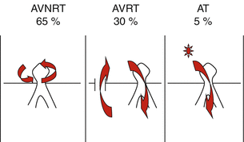
SVT(Supraventricular Tachycardia)
Cardiac Arrhythmias pp 199-208

Slide 3
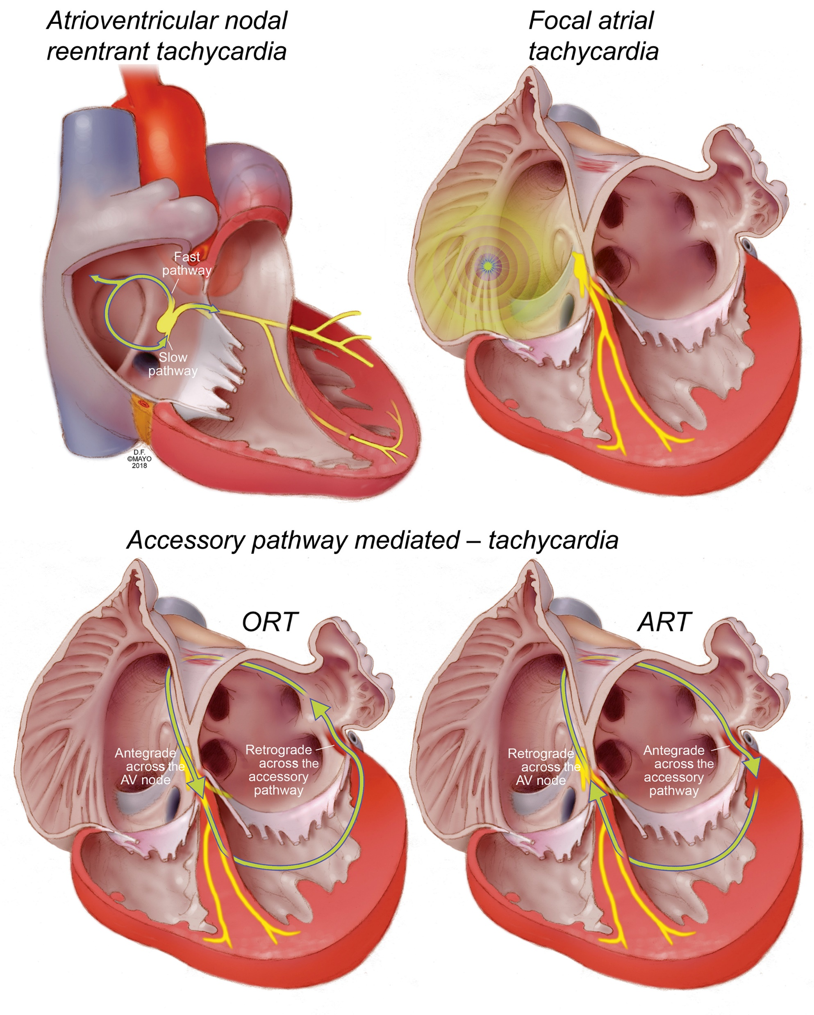
Mechanisms of SVT
Mayo Clinic Proceedings 2018 931825-1841

Slide 4
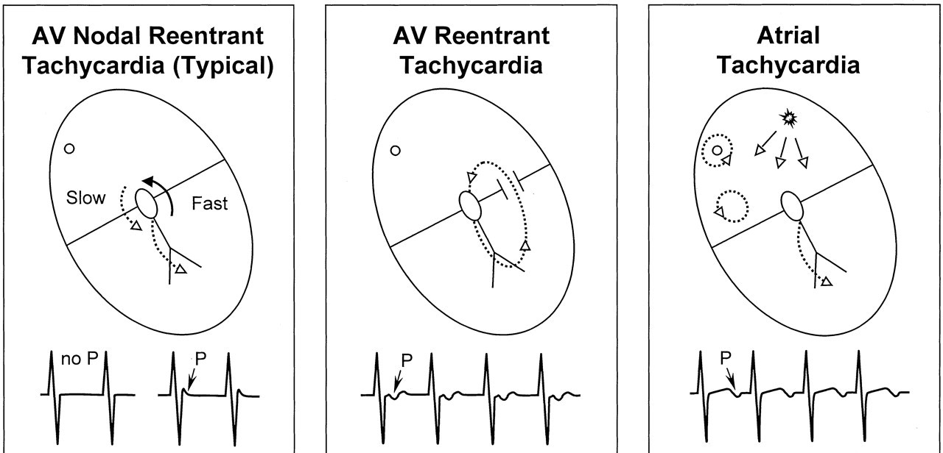
ECG of SVT : P wave
Circulation. 2003;107:1096–1099

Slide 5
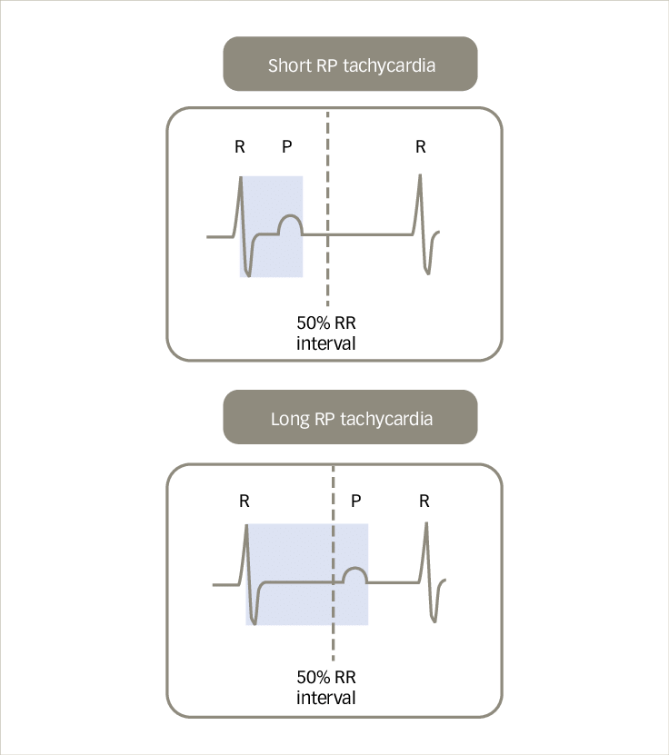
Short RP & Long RP tachycardia
Typical AVNRT
AVRT
AT
Atypical AVNRT
Supraventricular Tachycardia Diagnosis and Management. EUROPEAN JOURNAL OF ARRHYTHMIA & ELECTROPHYSIOLOGY 2021

Slide 6
Pacing maneuvers
Objective
  Accessory Pathway -> AVRT
  VA linking : Reentry <-> AT
During SR
  Para-Hisian Pacing
  Differential Pacing
During SVT
  His refractory PVC
  Ventricular Overdrive Pacing
  Atrial Overdrive Pacing
  Single Atrial Extrastimulus
Notes:
Single Atrial Extrastimulation
to distinguish between retrograde AV nodal conduction and AP conduction

Slide 7
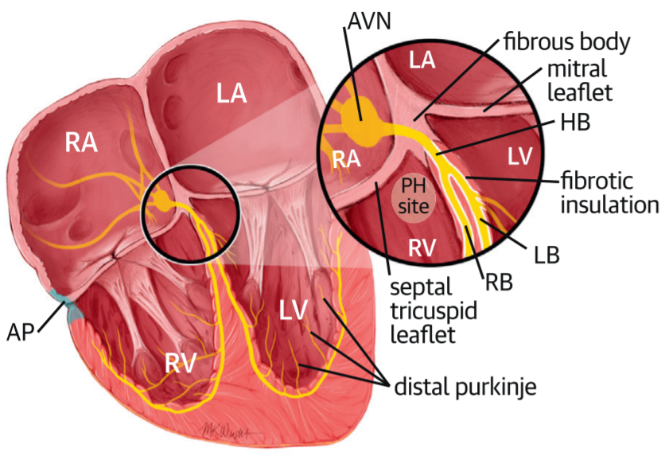
Para-Hisian Pacing (PHP)
Ali, H. et al. J Am Coll Cardiol EP.a 2019;5(11):1233–52.
Notes:
Used to confirm presence of retrograde conducting septal pathway

Slide 8
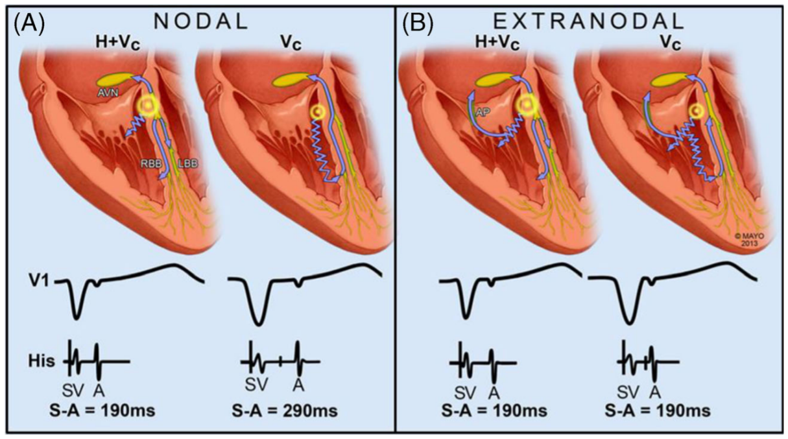
PHP - AVN response
J Interv Card Electrophysiol (2014) 40:105–116

Slide 9
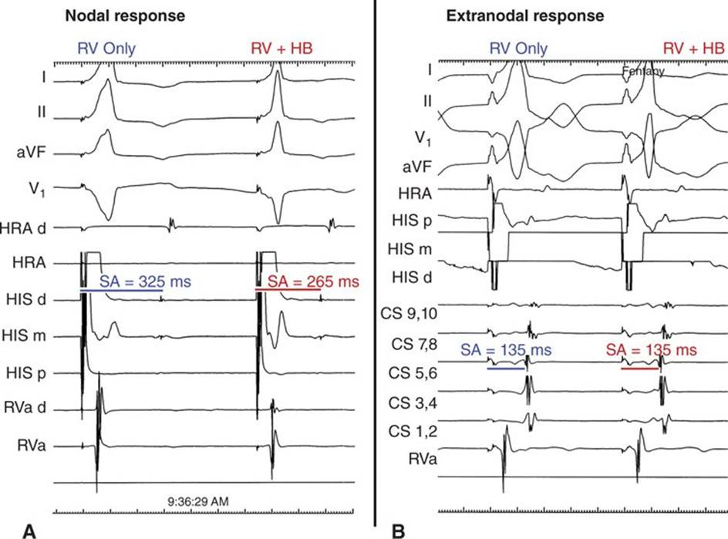
PHP - AVN response

Slide 10
PHP - AP response
J Interv Card Electrophysiol (2014) 40:105–116

Slide 11
PHP - AP response

Slide 12
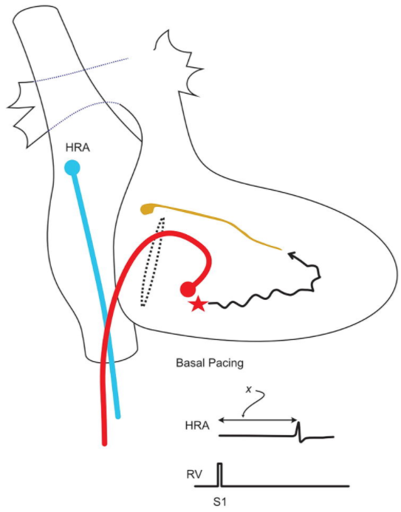
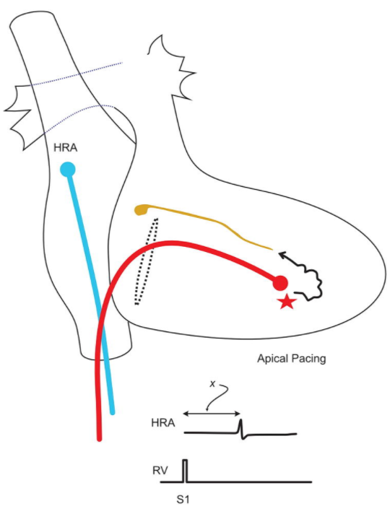
Differential Pacing - AVN response
https://ep-easy.com

Slide 13
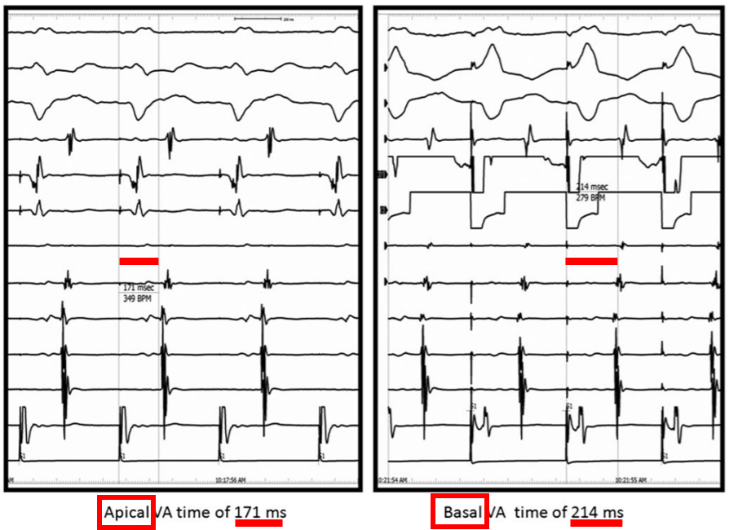
Differential Pacing – AVN response
The Journal of Innovations in Cardiac Rhythm Management, 4 (2013)

Slide 14
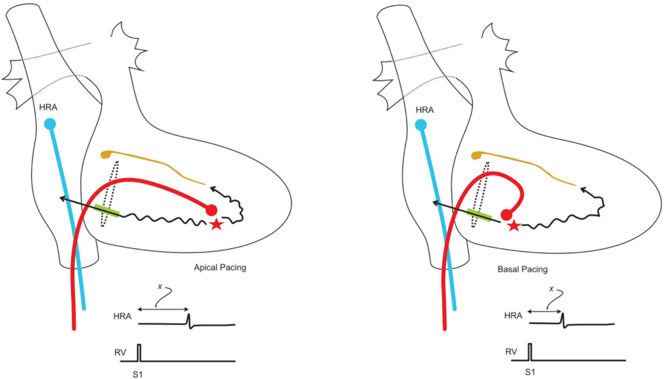
Differential Pacing - AP response
https://ep-easy.com
Notes:
Used to confirm presence of retrograde conducting septal pathway
Pace at basal & apex
This method is based on an early study of the differential VA interval (RV base − RV apex) during sinus rhythm; the differential VA interval is negative in the presence of an AP and positive in its absence. Because the AP is located in the basal area, the VA interval during pacing from the RV base is shorter in the presence of an AP, while the VA interval during pacing from the RV apex is shorter in the absence of an AP due to the proximity of the RV apex to the His-Purkinje system, which conducts to the AVN
Because the AP is located in the basal area, the VA interval during pacing from the RV base is shorter in the presence of an AP, while the VA interval during pacing from the RV apex is shorter in the absence of an AP due to the proximity of the RV apex to the His-Purkinje system, which conducts to the AVN

Slide 15
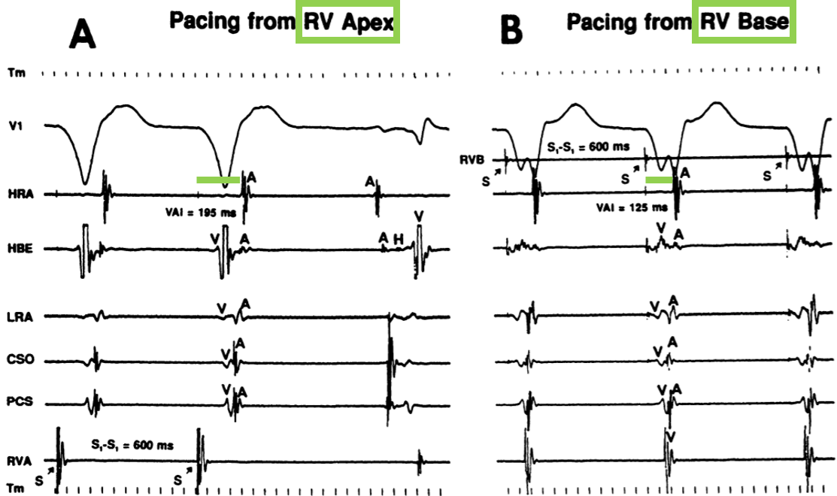
Differential Pacing - AP response
Circulation. 1994;89:1060-1067.

Slide 16
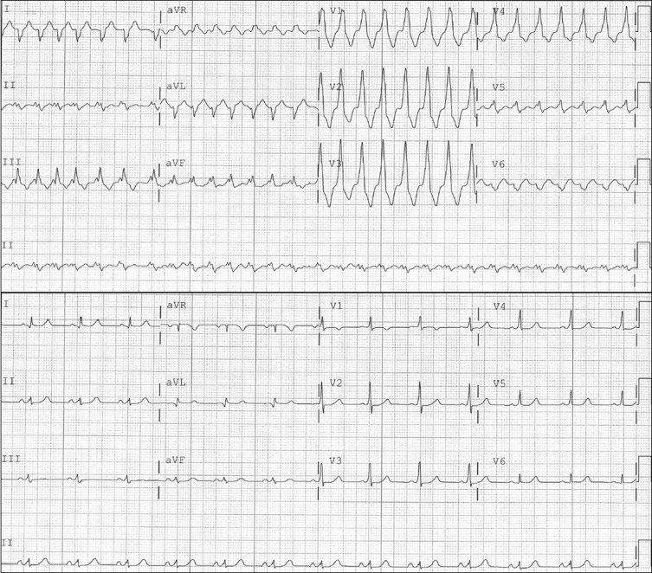
Case
Munro et al Heart Rhythm 2016
Atrial Tachycardia With Bystander Accessory Pathway
Notes:
Accessory pathway in SR …. Bystander ?

Slide 17
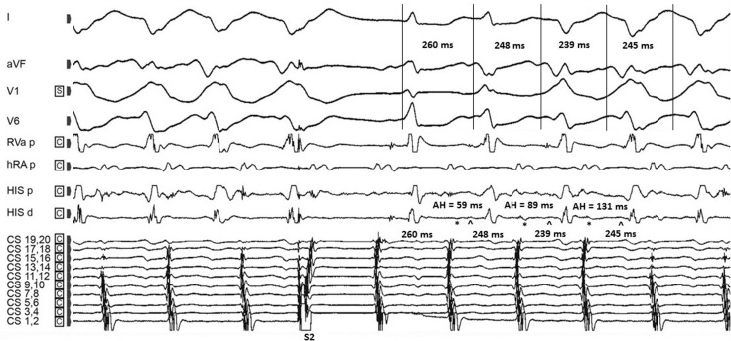
Pacing Maneuver :
Single Atrial Extrastimulus
Munro et al Heart Rhythm 2016
Atrial Tachycardia With Bystander Accessory Pathway
Notes:
Accessory pathway in SR …. Bystander ?

Slide 18
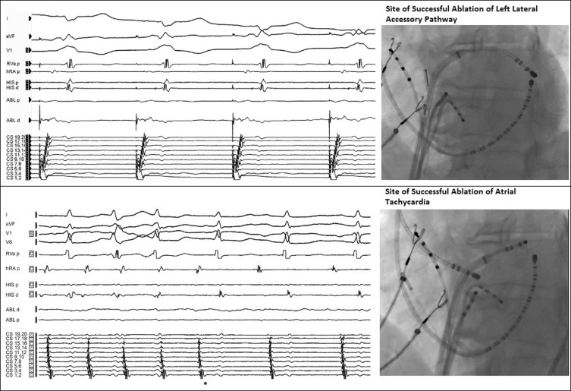
Septal AT with antegrade bystander AP
Munro et al
AT With Bystander AP
Heart Rhythm 2016

Slide 19
During SVT, Pacing Maneuvers
His refractory PVC
Ventricular Overdrive Pacing (VOP)
  Transition Zone Analysis
  Orthodromic & Antidromic His capture
  Post VOP response :
    VAV & VAAV
    Pseudo VAAV
  Post Pacing Interval (PPI) :
    PPI – TCL
    corrected PPI – TCL
Atrial Overdrive Pacing (AOP)
Single Atrial Extrastimulus (SAE)

Slide 20
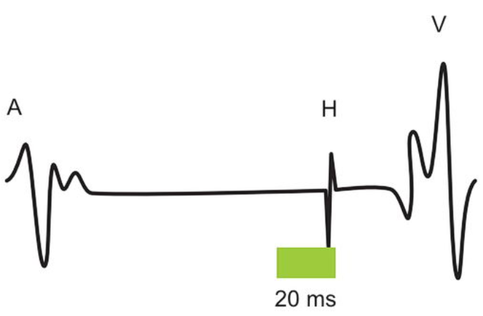
His refractory PVC
ep-easy.com

Slide 21
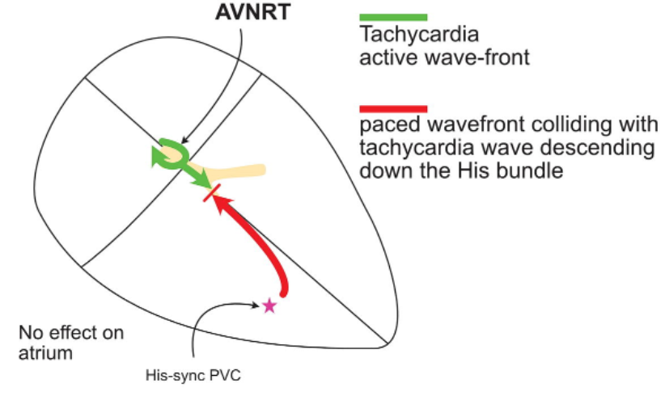
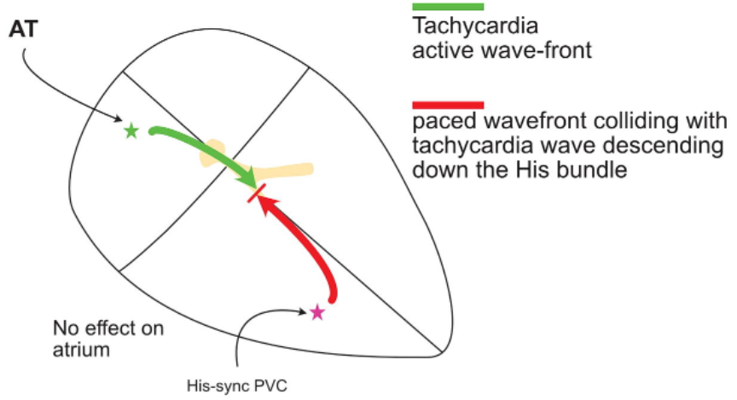
His refractory PVC
ep-easy.com
Notes:
His refractory pvc 는 circuit 에 들어갈수 없다

Slide 22
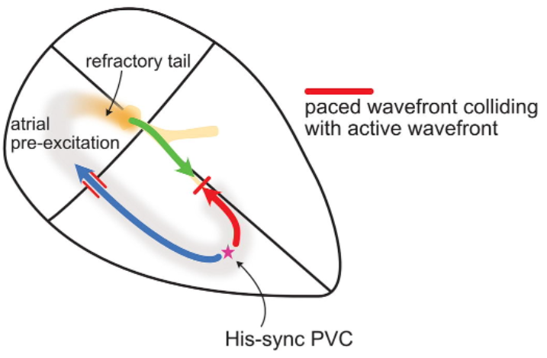
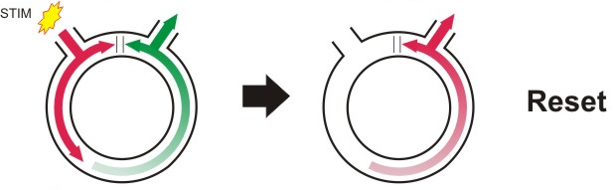
His refractory PVC
ep-easy.com

Slide 23
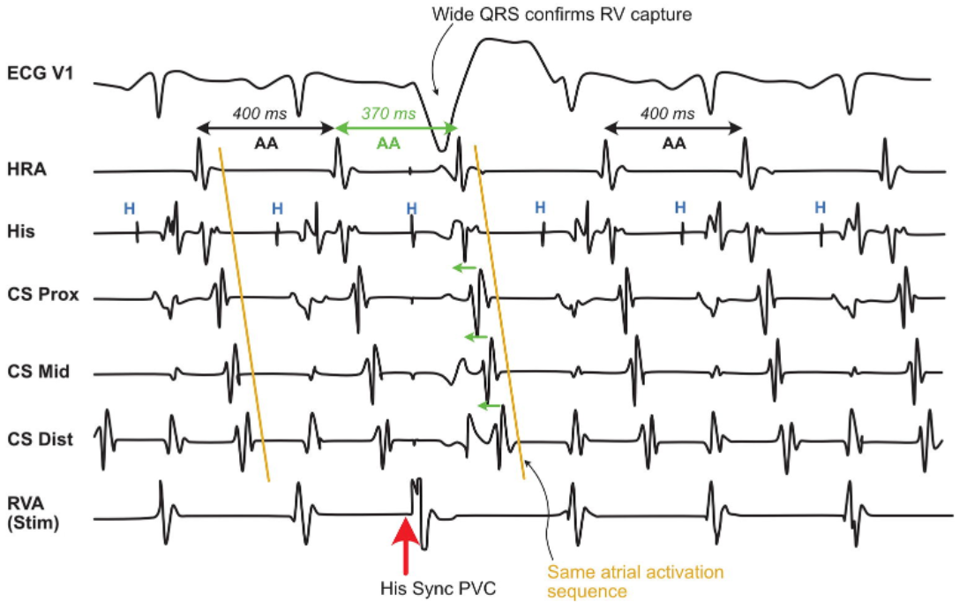
His refractory PVC
ep-easy.com

Slide 24
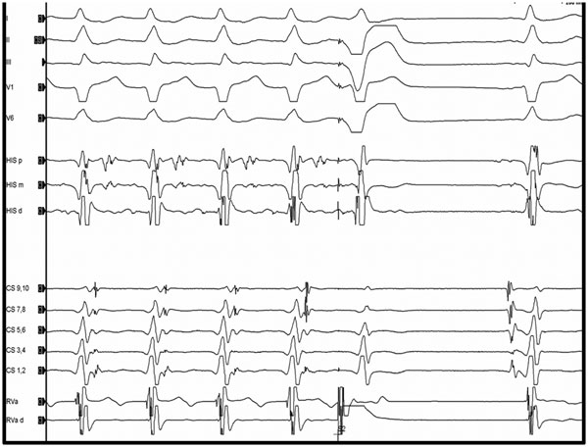
Case
K Kanjwal, A George and S K Mainigi. The Journal of Innovations in Cardiac Rhythm Management, 4 (2013), 1217–1230
Notes:
Terminate the tachycardia
Without conducting to the atrium
PVC block in AP
=> AP present & critical part of circuit
Idiopathic Fascicular vt with accessory pathway
AT with manifest accessory pathway – wide qrs

Slide 25
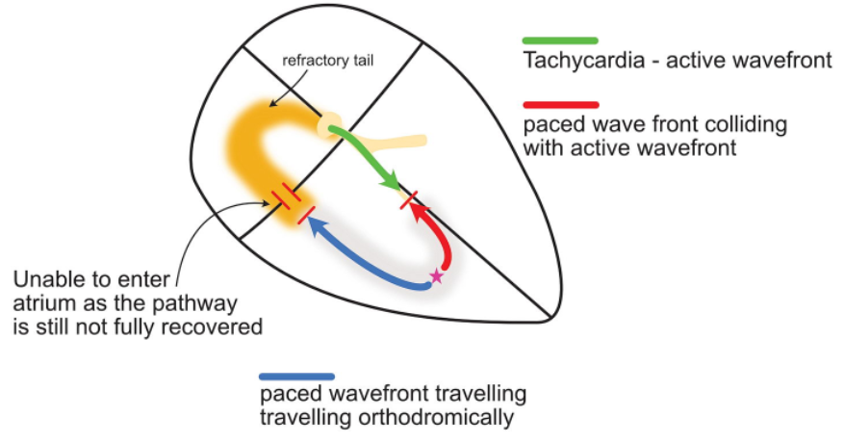
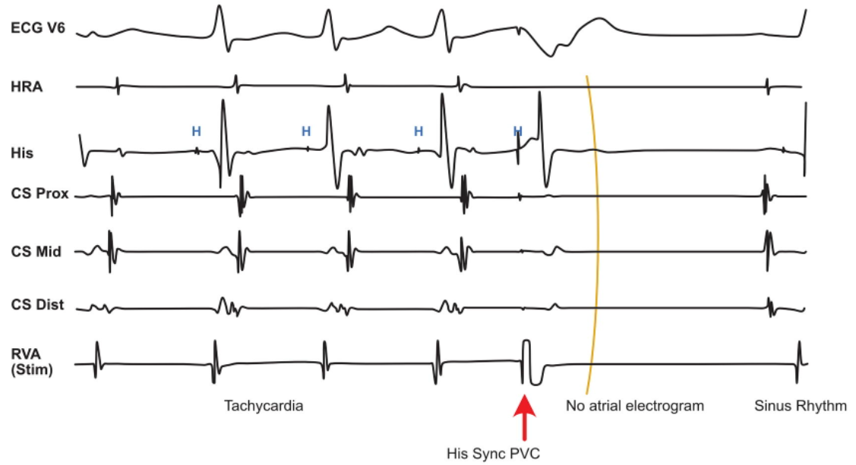
His refractory PVC
ep-easy.com
Notes:
For this phenomenon to occur, there must be an accessory pathway AND it should be participating in the tachycardia.

Slide 26
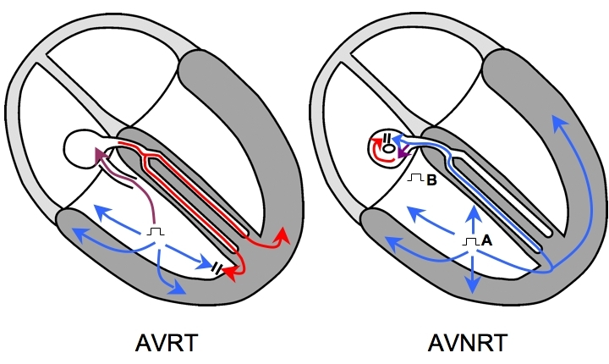
VOP (Ventricular Overdrive Pacing)
Repeated Resetting
Pacing CL : 30ms shorter than TCL
Pacing site : RV
  close circuit in AVRT
  distant circuit in AVNRT
Notes:
Avrt circuit 내에서 pacing
Avnrt circuit 밖에서 pacing

Slide 27
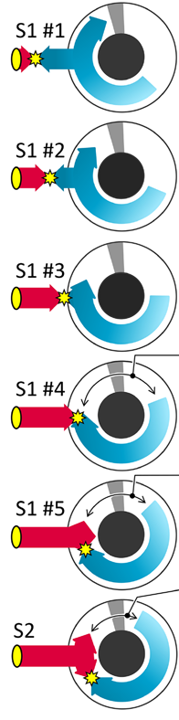
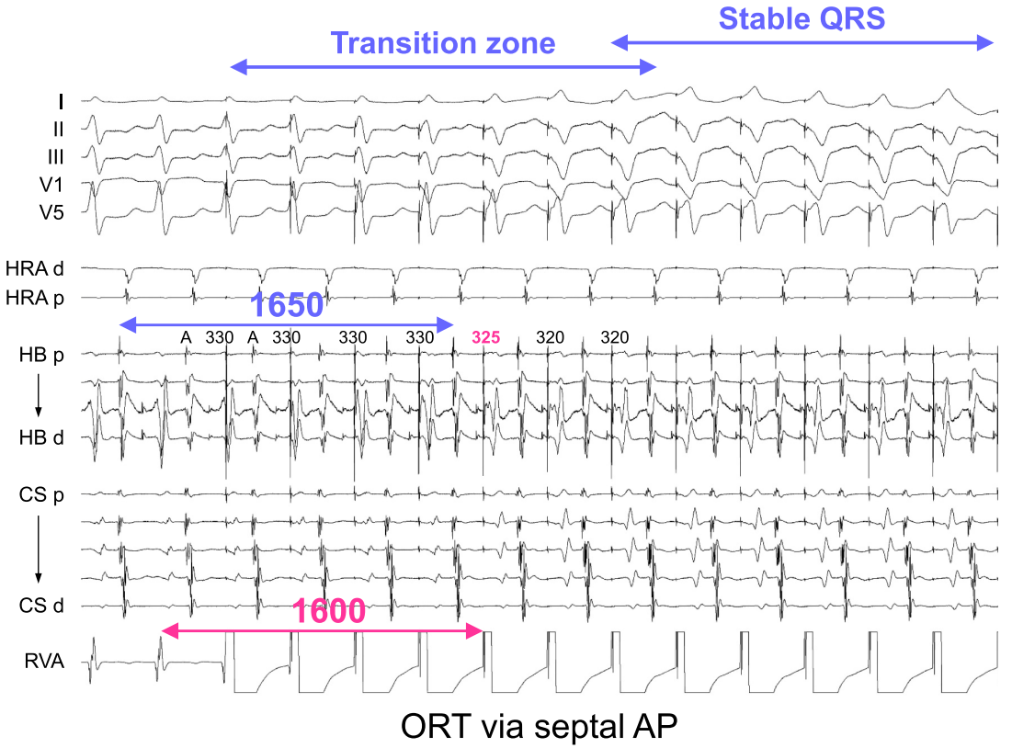
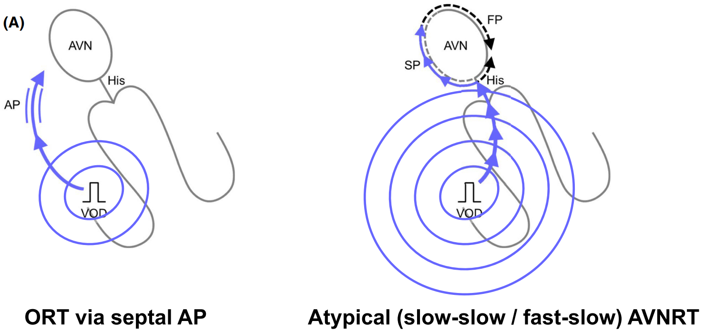
Transition Zone Analysis
Notes:
They defined a “transition zone” as the period during which paced complexes exhibit progressive QRS fusion up to the first paced complex that shows stable QRS morphology, as determined through a 12-lead ECG analysis
RV pacing 30ms shorter than TCL

Slide 28
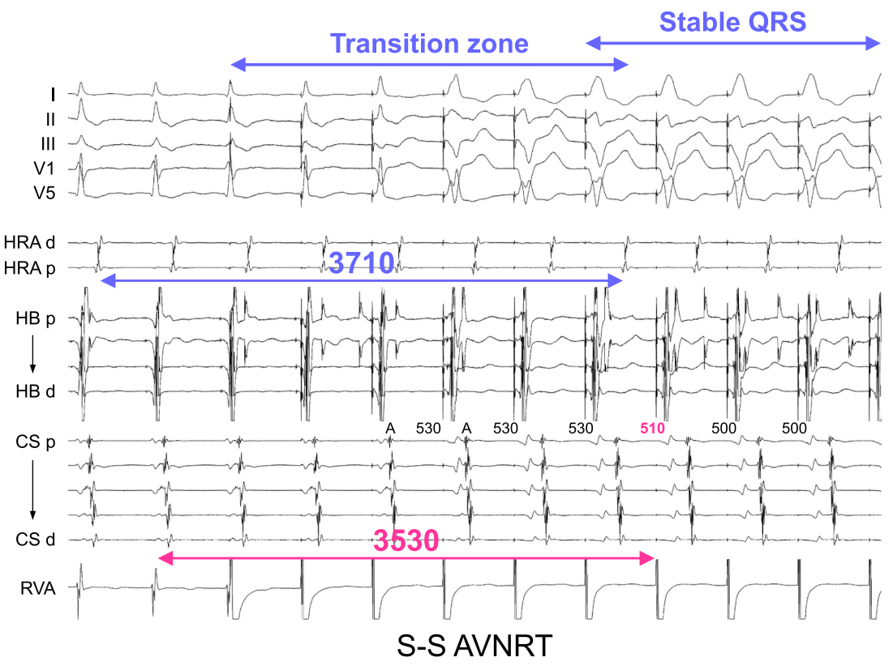
Transition Zone Analysis
NAGASHIMA et al. Journal of Arrhythmia. 2024;40:767–785.
Notes:
atrial timing perturbations and the fixed SA interval manifest after the transition zone in AVNRT
atrial timing perturbations after the transition zone in AVNRT

Slide 29
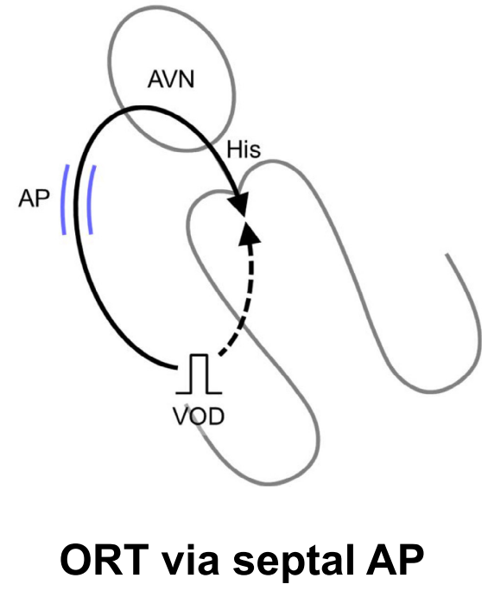
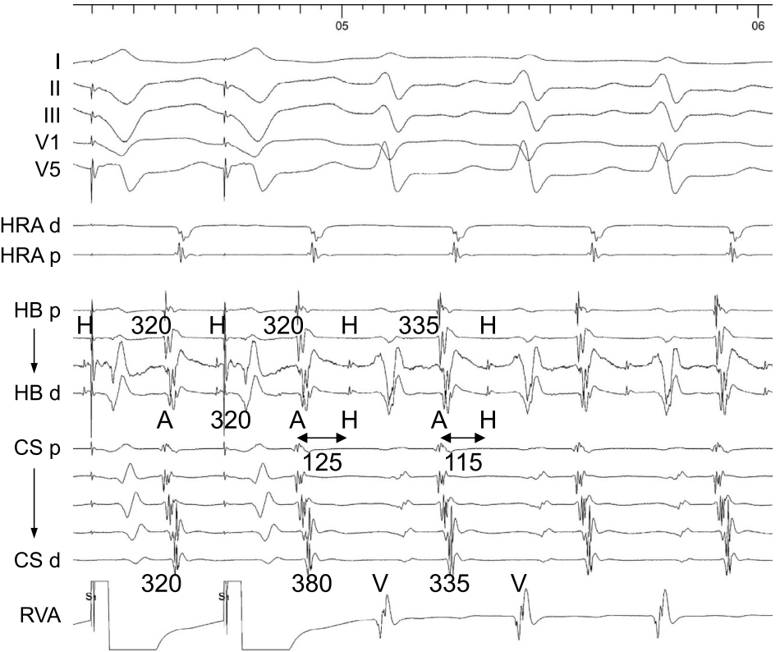
Orthodromic His capture
NAGASHIMA et al. Journal of Arrhythmia. 2024;40:767–785.

Slide 30
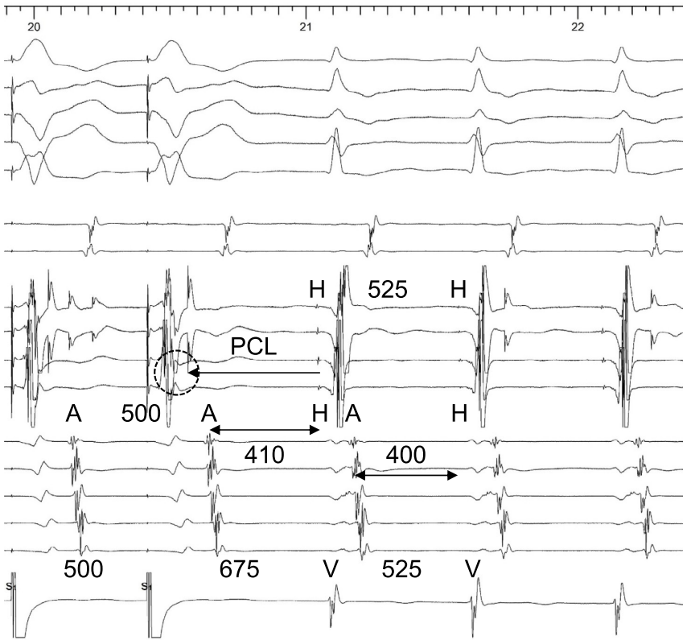
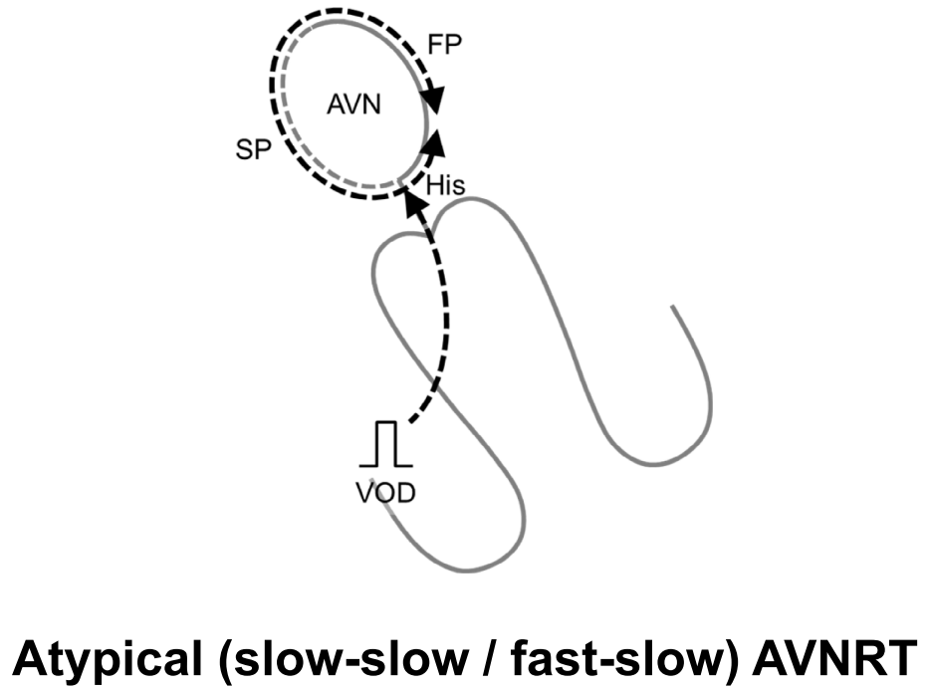
Antidromic His capture
NAGASHIMA et al. Journal of Arrhythmia. 2024;40:767–785.
Notes:
the His bundle is always activated retrogradely (antidromic His capture) to entrain the AVN circuit
The retrograde His bundle electrogram is often obscured by overlapping ventricular electrograms

Slide 31
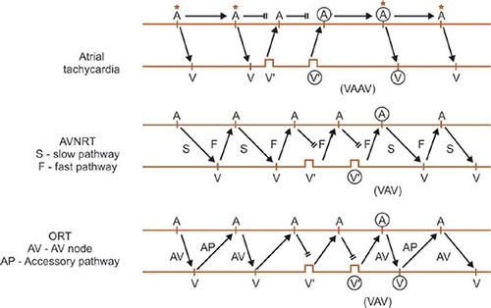
Post VOP response

Slide 32
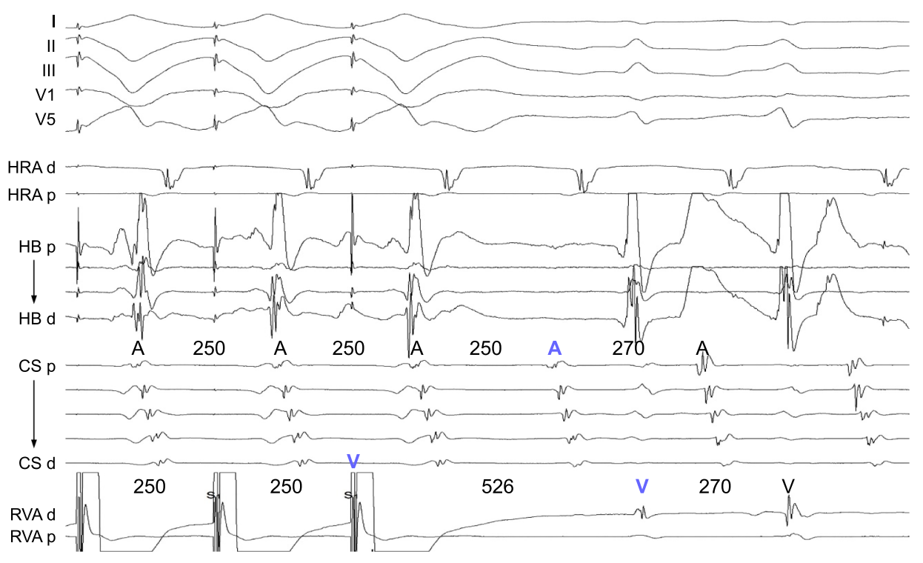
Pseudo VAAV response
NAGASHIMA et al. Journal of Arrhythmia. 2024;40:767–785.
Notes:
Pseudo VAAV response after VOP fast slow AVNRT
Paced ventricular interval to exceed PCL
f/s avnrt
Ort via AP with decremental conduction

Slide 33
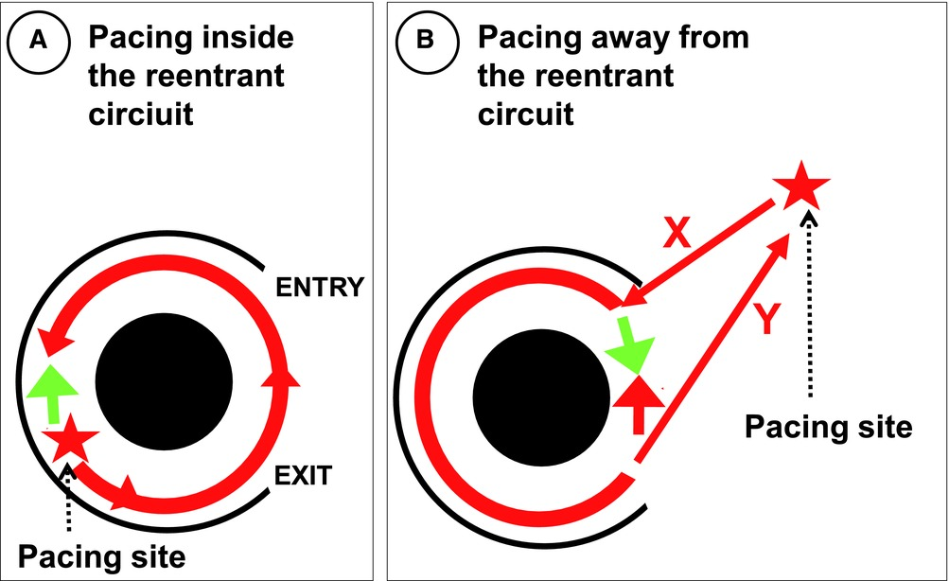
Post Pacing Interval (PPI)

Slide 34
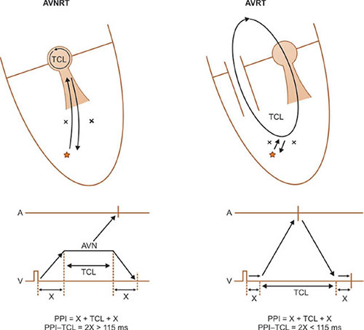
PPI – TCL = 2X : 115ms
Practical Cardiac Electrophysiology
Notes:
2X : twice the conduction time
from pacing catheter
through RV muscle & His-purkinje system
before reentry circuit.
: Pacing site 부터 Circuit 까지 거리의 두배
TCL : reentry circuit

Slide 35
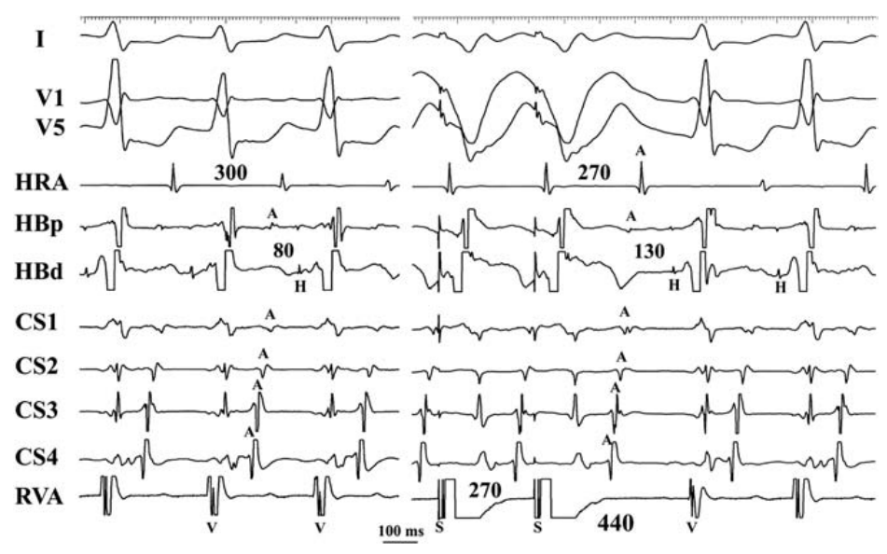
Corrected PPI – TCL : 110ms
PPI – TCL = 440 – 300 = 140
cPPI – TCL – increase in AH
= 440 – 300 – (130-80)
= 140 – 50 = 90
González-Torrecilla et al. Heart Rhythm 2006
Notes:
Lt. lateral AP
PPI – TCL = 440 – 300 = 140
increase in the first return AH interval = first return AH interval - AH interval prior to entrainment
cPPI – TCL – increase in AH
= 440 – 300 – (130-80)
= 140 – 50 = 90
VOP 에서 TCL 보다 20~30ms 빠르게 pacing 하므로
AVN의 decremental conduction 때문에 PPI가 더 늘어난다
이것은 ORT underdiagnosed … 이것을 해결하기위해 cPPI –TCL 나옴.
VOD 동안, AVN conduction time 늘어나는 것을 보상하기위해서 등장

Slide 36
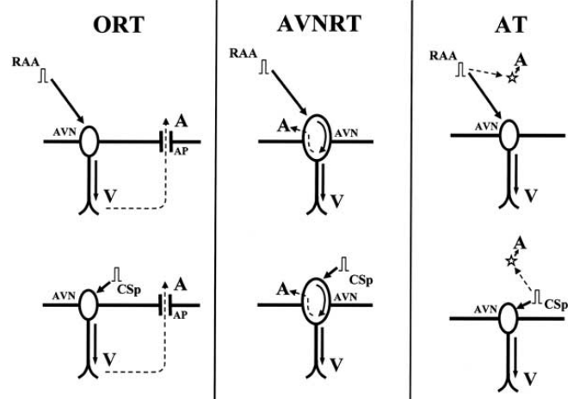
Atrial Overdrive Pacing
Pacing site : RAA & CSp
Post pacing VA interval
  ORT & AVNRT : fixed
  AT : variable
Delta VA = VA(RAA) – VA(CSp)
      <14ms : AVNRT or AVRT
      >14ms : AT
Maruyama et al. Journal of Cardiovascular Electrophysiology Vol. 18, No. 11, November 2007
Notes:
Conversely, a ΔVA interval >14 ms (later modified as 20 ms)15 indicates a lack of VA linking and is diagnostic for AT because the postpacing VA intervals reflect the difference in times between the last atrial pacing capturing the ventricle and the last pacing capturing the AT origin, which varies according to the proximity of the pacing site to AVN and AT origin (Figure 4C). The presence of Vv에 의해 a 가 결정되므로 즉 va linkingA linking excludes AT with 100% sensitivity and specificity

Slide 37
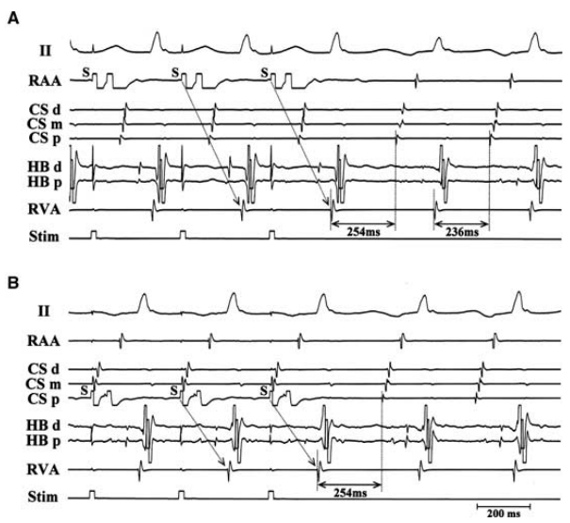
AOP in atypical AVNRT
Post AOP, VA interval
  RAA pacing : 254ms
  CSp pacing : 254ms
  △ VA interval = 0ms < 14ms
Maruyama et al. Journal of Cardiovascular Electrophysiology Vol. 18, No. 11, November 2007

Slide 38
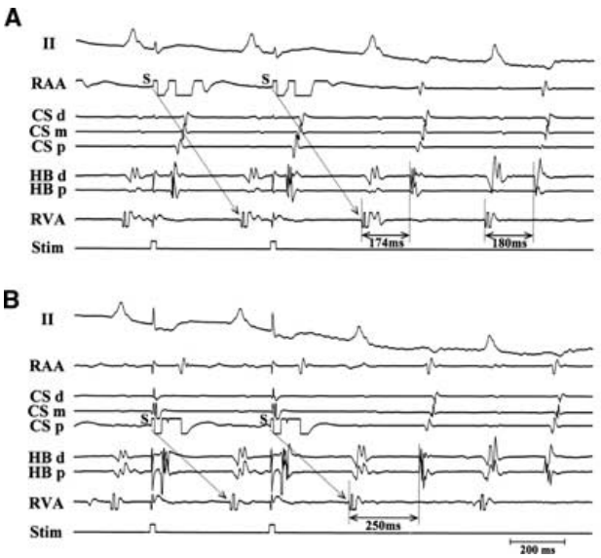
AOP in AT
Post AOP, VA interval
  RAA pacing : 174ms
  CSp pacing : 250ms
  △ VA interval = 76ms > 14ms
Maruyama et al. Journal of Cardiovascular Electrophysiology Vol. 18, No. 11, November 2007

Slide 39
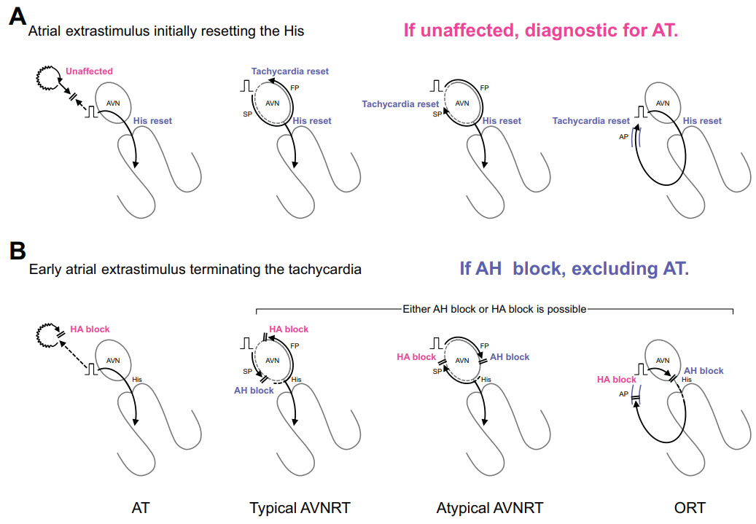
Single Atrial Extrastimulus
NAGASHIMA et al.
Journal of Arrhythmia. 2024
Notes:
This extrastimulus is applied in the proximal CS, with the coupling interval gradually decreased until it first resets the His bundle, and is continued until tachycardia termination. Tachycardia reset is identified by measuring the atrial interval over two cycles surrounding the extrastimulus. The lack of tachycardia reset immediately following an atrial extrastimulus that initially resets the His electrogram confirms AT with 96% sensitivity and 100% specificity (Figure 6A).18 Additionally, tachycardia termination via an AH block induced by the atrial extrastimulus excludes AT with 92% sensitivity and 100% specificity

Slide 40
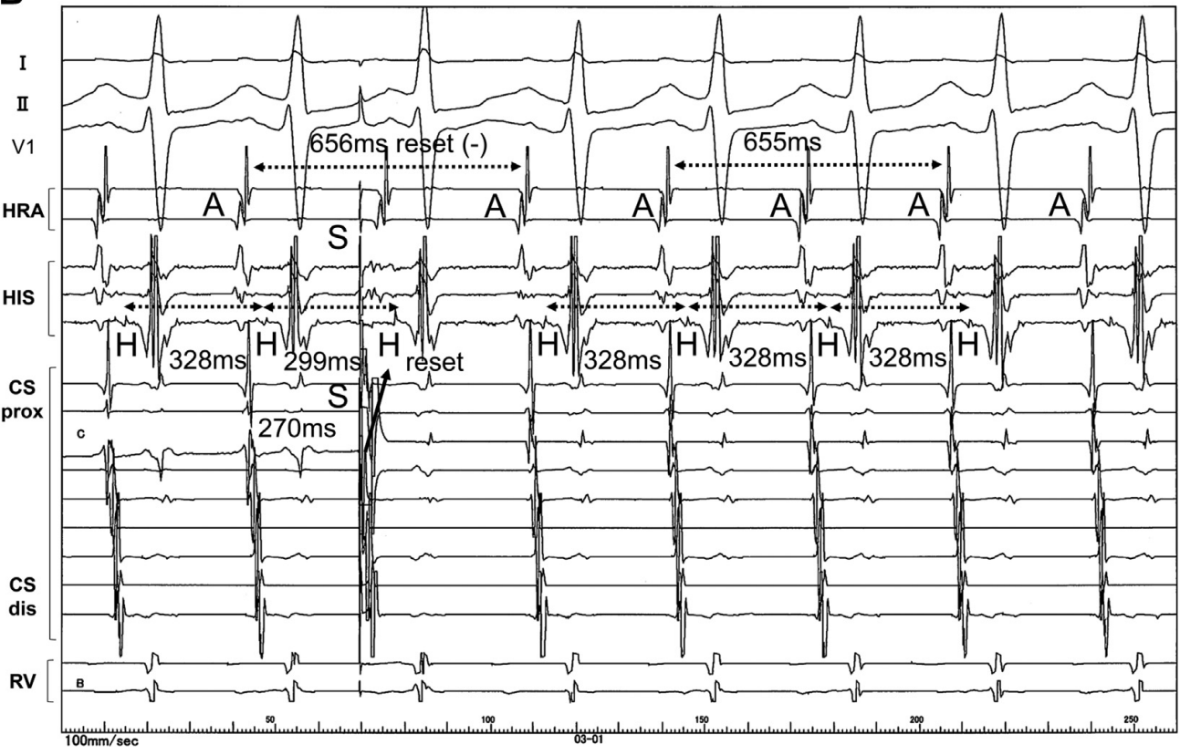
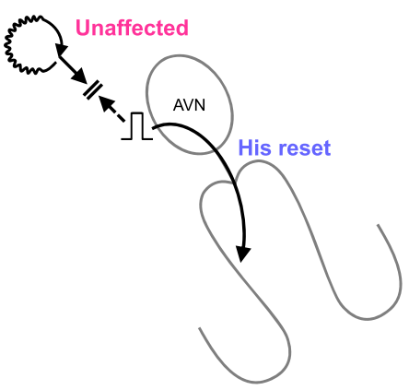
Single Atrial Extrastimulus
Inaba et al. 2004
Notes:
(H-H) interval becomes 299 milliseconds, indicating that the HB is reset
The length of the 2 atrial beats when the HB was reset is equal to the length of the 2 cycles of AT, indicating that tachycardia is not affected
(A) Single atrial extrastimulation (SAE) is performed from the proximal coronary sinus (CS) in a patient with atrial tachycardia (AT) with a tachycardia period of 330 milliseconds. The His bundle (HB) is not reset for SAE with a coupling interval of 300 milliseconds. (B) When the coupling interval of the SAE is gradually reduced to 270 milliseconds, the His bundle–His bundle (H-H) interval becomes 299 milliseconds, indicating that the HB is reset with the proceeded pattern (arrow). The length of the 2 atrial beats when the HB was reset is equal to the length of the 2 cycles of AT, indicating that tachycardia is not affected. A ¼ atria; dis ¼ distal; HRA ¼ high right atria; prox ¼ proximal; RV ¼ right ventricle; S ¼ stimulation.

Slide 41
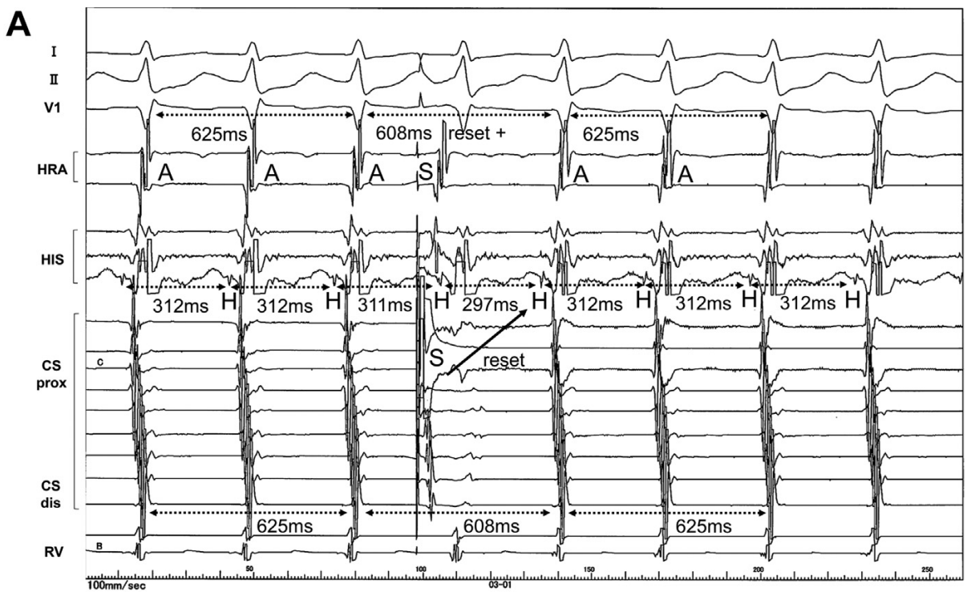
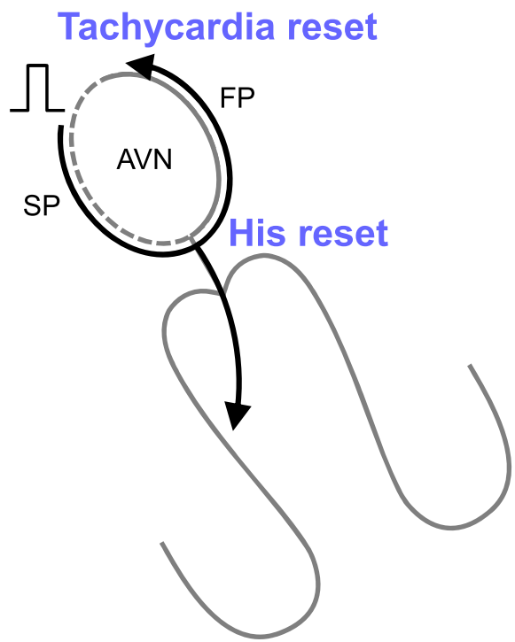
Single Atrial Extrastimulus
Typical AVNRT
Inaba et al. 2004
Notes:
The patterns of HB resetting by SAE and the tachycardia response to SAE are shown. (A) SAE is performed for the typical atrioventricular nodal re-entrant tachycardia with a tachycardia cycle length of 310 milliseconds. The H-H interval is shortened to 297 milliseconds owing to SAE, indicating that the HB is reset with the proceeded pattern (arrow). Additionally, the duration of the atrial 2 beats is shortened to 608 milliseconds, which is shorter than the tachycardia cycle, indicating that the tachycardia is simultaneously reset. (B) SAE is performed for the atrioventricular nodal re-entrant tachycardia with a tachycardia cycle length of 440 milliseconds. The H-H interval at HB resetting is prolonged to 476 milliseconds, indicating resetting in a decremented pattern (arrow). At that time, the length of the 2 atrial beats is extended to 906 milliseconds, indicating that the tachycardia was reset simultaneously. (C) An SAE is performed for the atrioventricular nodal re-entrant tachycardia with a tachycardia cycle length of 438 milliseconds. SAE caused an atrio-Hisian (AH) block and tachycardia is terminated

Slide 42
Single Atrial Extrastimulus for AT
NAGASHIMA et al.
Journal of Arrhythmia. 2024
Notes:
This extrastimulus is applied in the proximal CS, with the coupling interval gradually decreased until it first resets the His bundle, and is continued until tachycardia termination. Tachycardia reset is identified by measuring the atrial interval over two cycles surrounding the extrastimulus. The lack of tachycardia reset immediately following an atrial extrastimulus that initially resets the His electrogram confirms AT with 96% sensitivity and 100% specificity (Figure 6A).18 Additionally, tachycardia termination via an AH block induced by the atrial extrastimulus excludes AT with 92% sensitivity and 100% specificity

Slide 43
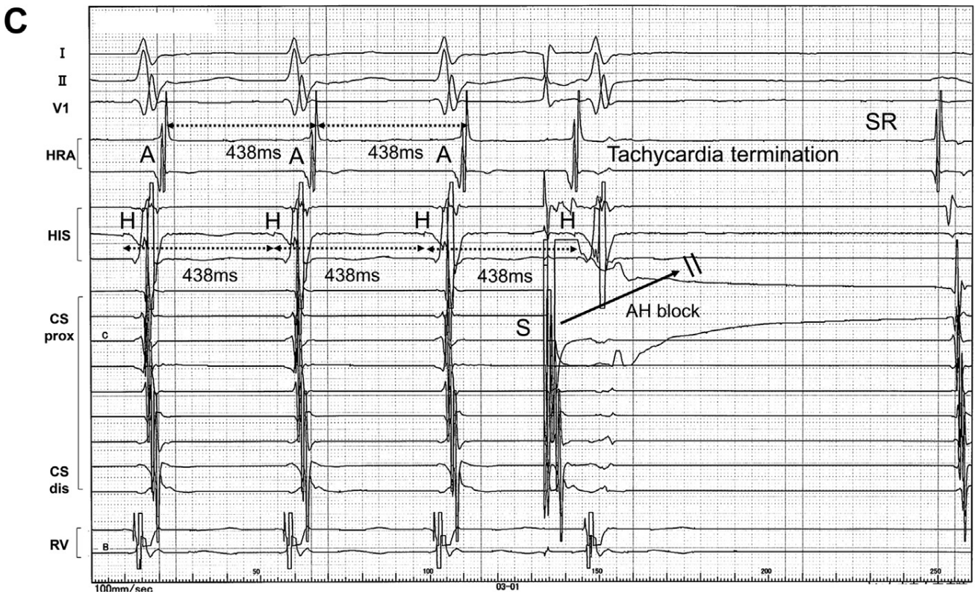
Single Atrial Extrastimulus
Inaba et al. 2004

Slide 44
Thank you

