Slide 1
New Ablation Technologies: In the Future…
VT Symposium 2022
Dec 3, 2022
Jaemin Shim, MD, PhD
Arrhythmia Center,
Korea University Anam Hospital, Seoul, Korea

Slide 2
Newer Methods for VT Ablation
To improve RF lesion
Half-normal saline irrigation
Simultaneous unipolar RF ablation
Bipolar RF ablation
Intramural needle ablation
Alternatives to RF
Retrograde ethanol ablation
Cryoablation
Laser ablation
Shock-wave catheter ablation
Stereotactic radioablation
Pulsed field electroporation

Slide 3
Half-normal Saline Irrigation
Decreasing the ionic content of the fluid surrounding the catheter-tip electrode increases the resistance of current flow through the surrounding blood, increasing preferential current delivery into the myocardium.
Stevenson WG, et al. Can J Cardiol. 2022.

Slide 4
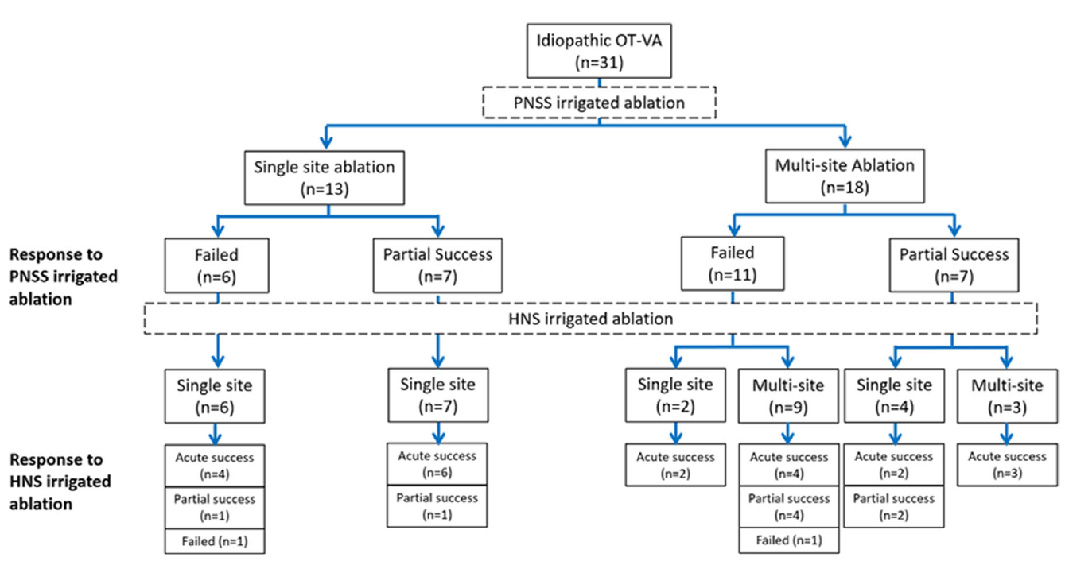
Half-normal Saline Irrigation
Out of 160 OT‐VA cases (51±15‐year‐old, 62 males), 31 underwent HNS irrigation after a failed standard NS‐irrigated ablation
Additional acute success in 21 of 31 (67.7%) patients
Chung FP, et al. J Cardiovasc Electrophysiol. 2019;30(9):1508-1516.

Slide 5
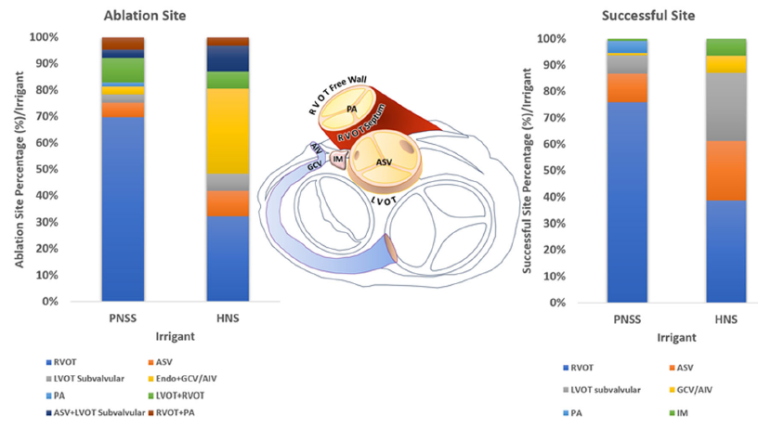
Half-normal Saline Irrigation
Out of 160 OT‐VA cases (51±15‐year‐old, 62 males), 31 underwent HNS irrigation after a failed standard NS‐irrigated ablation
Chung FP, et al. J Cardiovasc Electrophysiol. 2019;30(9):1508-1516.

Slide 6
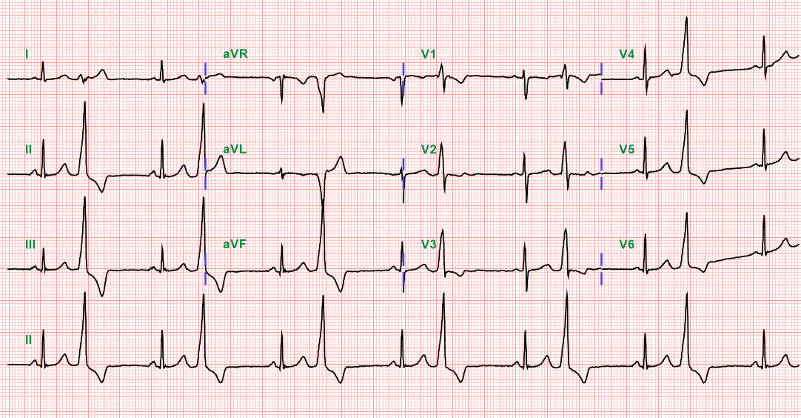
CASE
RNH #1989619
30-year-old female, syncope with palpitation
4 times of RFCA for OT VT/PVC (RVOT & LVOT) at other hospital
No SHD, LVEF=55%

Slide 7
CASE
RNH #1989619
Serial ECG changes
I
aVR
V1
V4
II
aVL
V2
V5
III
aVF
V3
V6

Slide 8
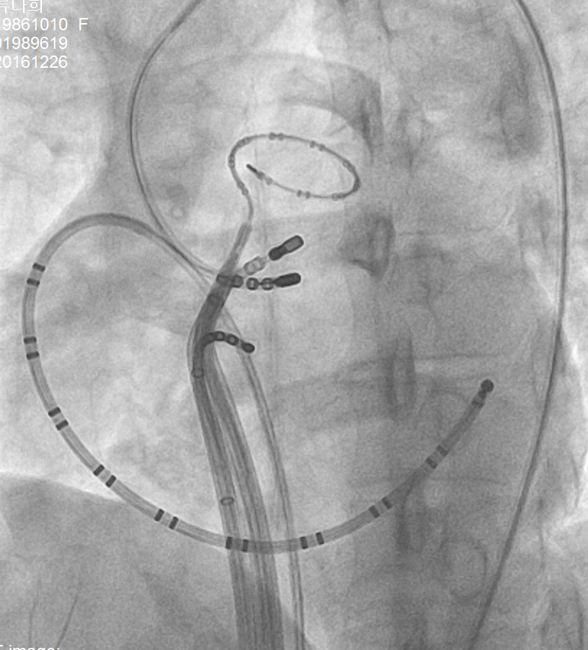
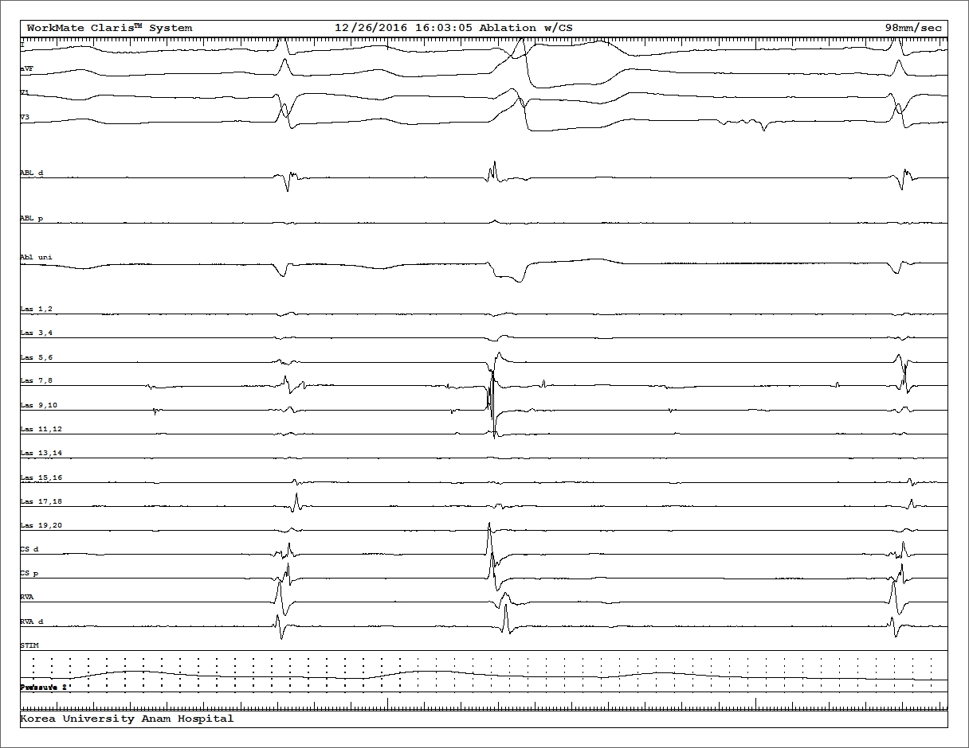
CASE
RNH #1989619
Ablation at RCC, EA 21ms
ABLd
EA 21ms
ABLp

Slide 9
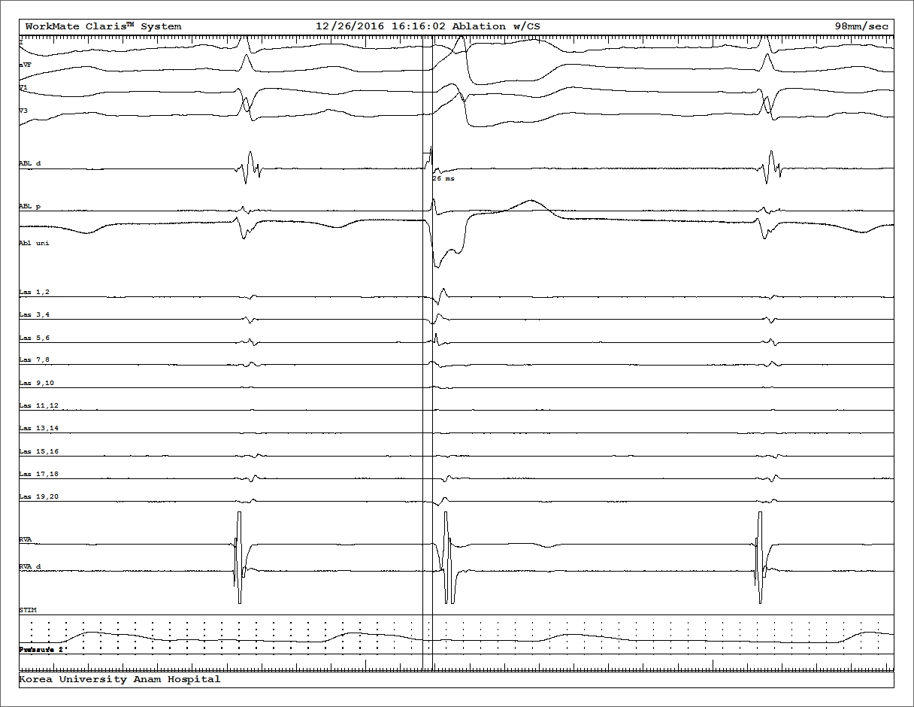
CASE
RNH #1989619
Ablation at anteroseptum of RVOT
EA 26 ms
ABLd
EA 26ms
ABLp

Slide 10
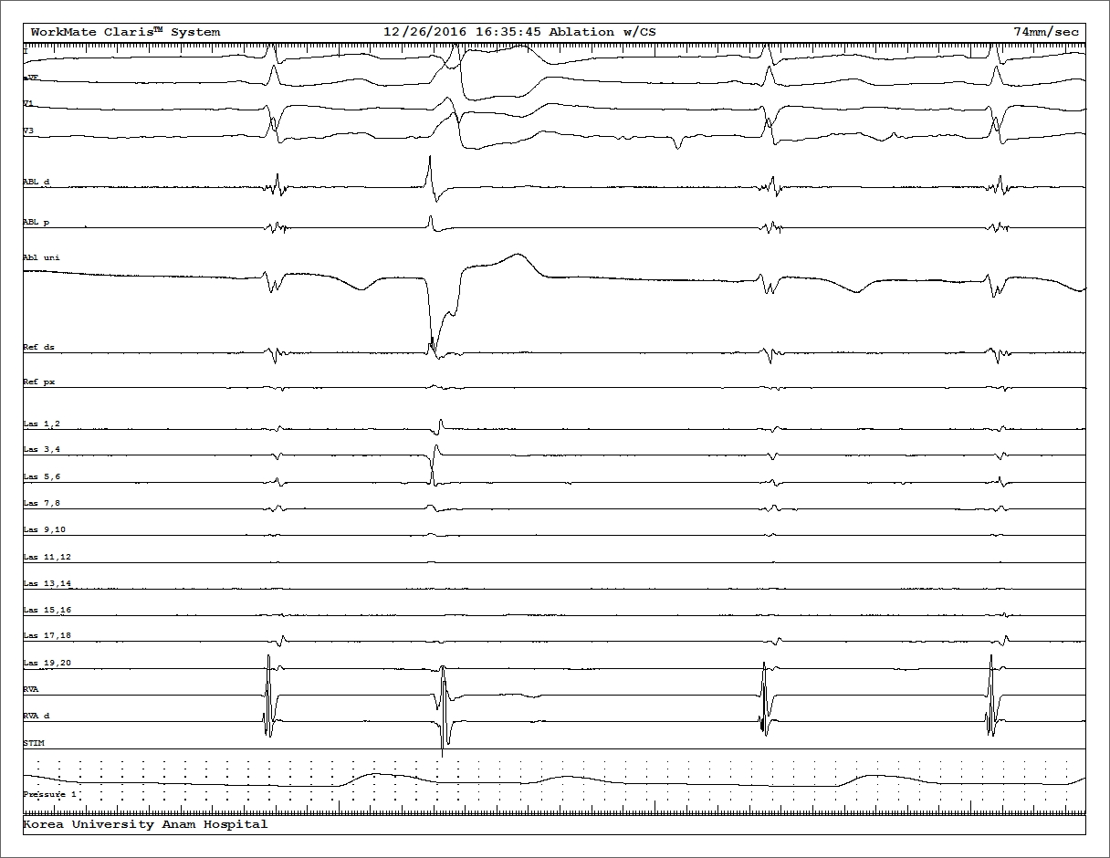
CASE
Bipolar ablation
RCC: Active ablation
RVOT: Return electrode
LAO
RAO
ABL RCC d
ABL RCC p
EA 29ms
ABL RVOT d
ABL RVOT p

Slide 11
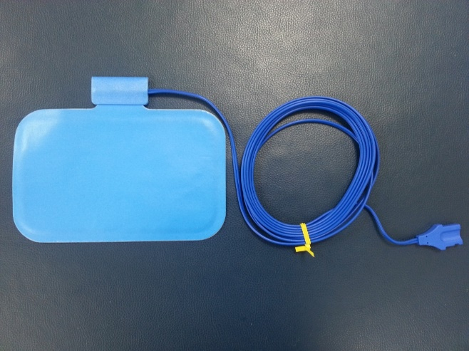
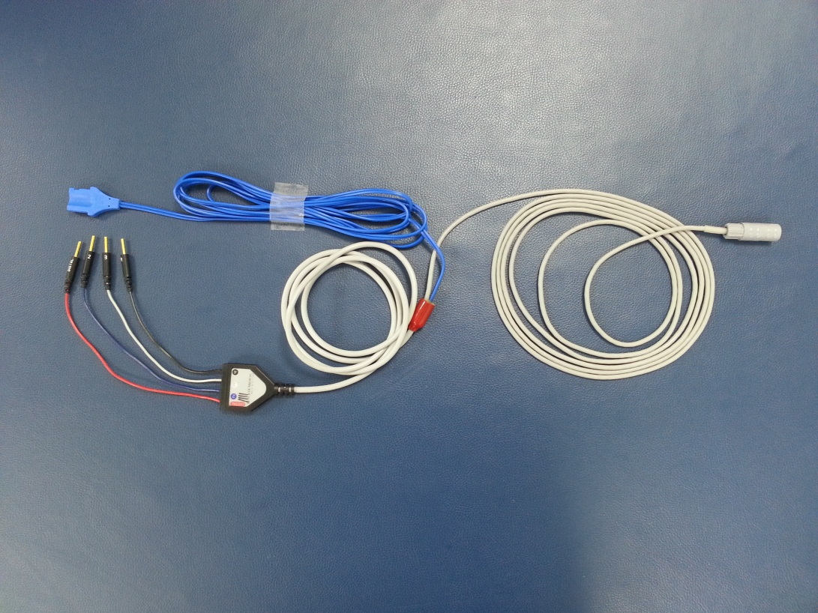
CASE
Bipolar ablation
RCC: Active ablation
RVOT: Return electrode
Patient Return Electrode
RF Generator
To Ablation Catheter
Indifferent Electrode EGM Recording

Slide 12
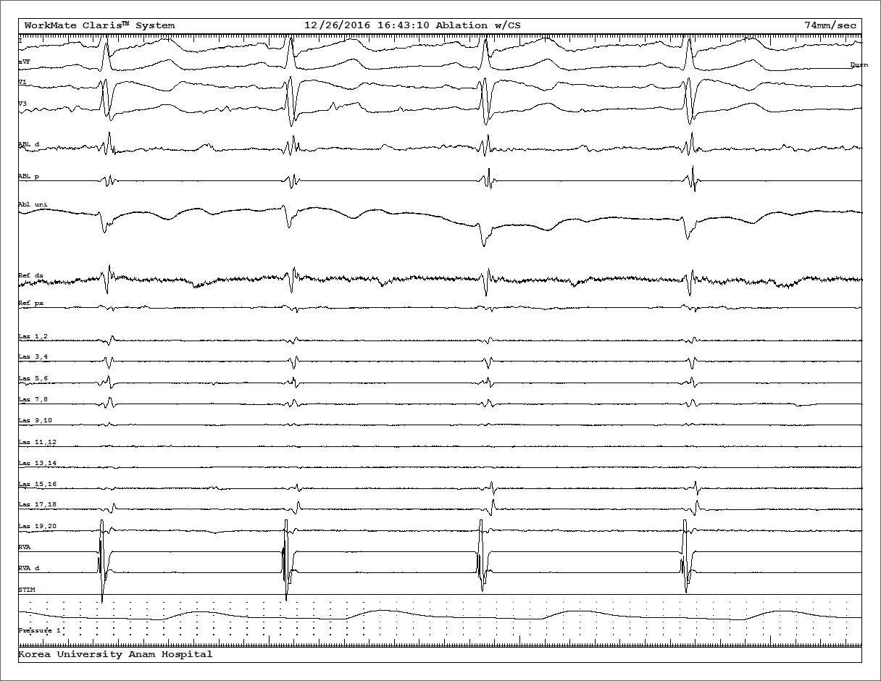
CASE
RNH #1989619
During bipolar ablation
ABL RCC d
ABL RCC p
ABL RVOT d
ABL RVOT p

Slide 13
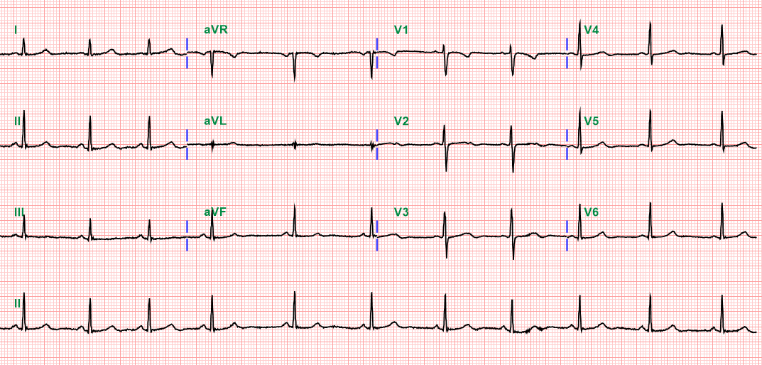
CASE
RNH #1989619
After ablation

Slide 14
Techniques for 2-site Ablation
Simultaneous unipolar ablation
Bipolar ablation
Stevenson WG, et al. Can J Cardiol. 2022.

Slide 15
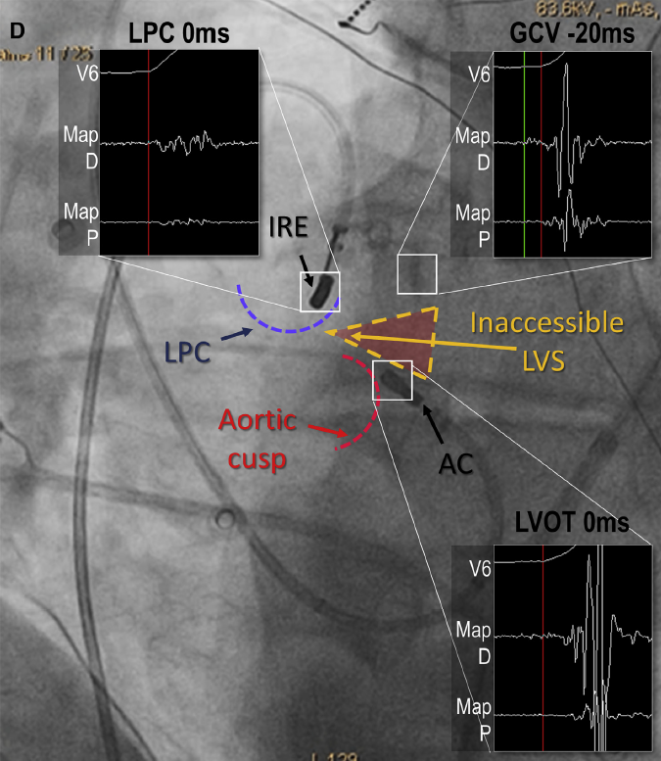
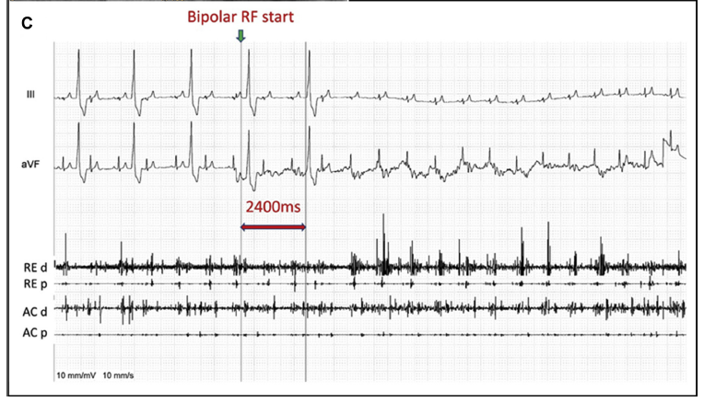
Bipolar Ablation between the Left Pulmonic Cusp (LPC) and LVOT for LV Summit VAs
Seven patients (age 59±12 years; 3 women) underwent Bi-RF from the LPC to the LVOT for LVS-VAs after ≥1 failed conventional RFCA
Futyma P, et al. Heart Rhythm. 2020 Sep;17(9):1519-1527.

Slide 16
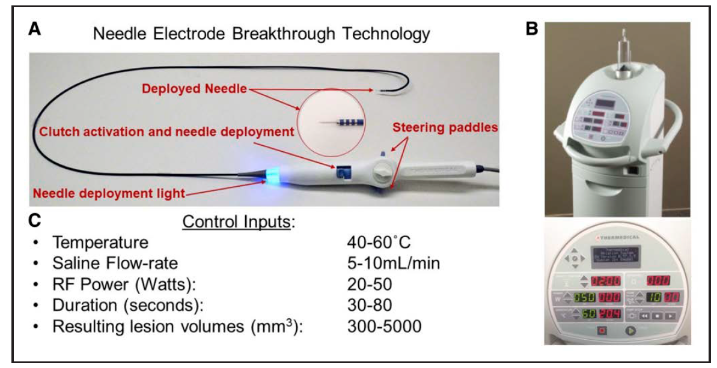
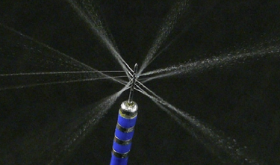
Needle RF Ablation: A First-in-Man Trial
Intramural needle ablation using in-catheter, heated saline-enhanced radio frequency (SERF) energy
Thirty-two subjects from 6 centers (91% male, 66±10 years, EF 35±11%; 56% ischemic, and 44% nonischemic)
SERF needle electrode and ablation generator system
Packer DL, et al. Circ Arrhythm Electrophysiol. 2022.

Slide 17
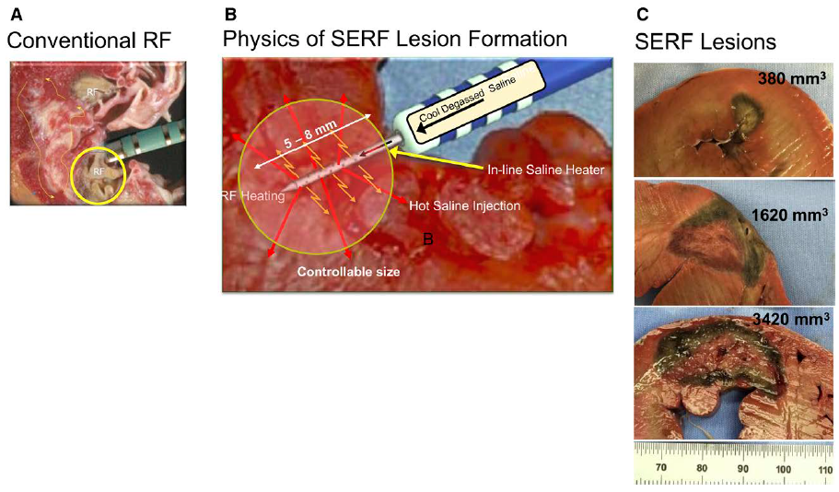
Needle RF Ablation: A First-in-Man Trial
Lesion creation with standard RF and SERF ablations
Packer DL, et al. Circ Arrhythm Electrophysiol. 2022.

Slide 18
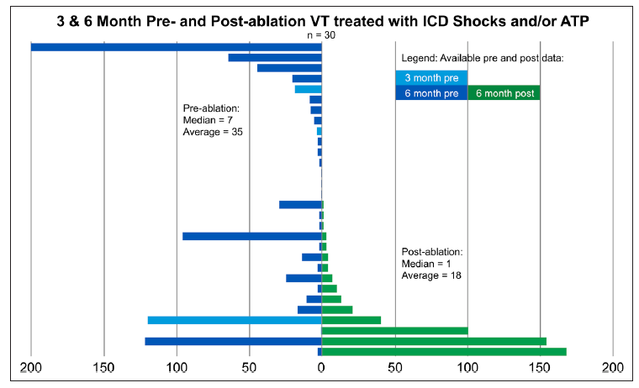
Needle RF Ablation: A First-in-Man Trial
Pre- and postprocedure VT occurrences and ICD therapies
Packer DL, et al. Circ Arrhythm Electrophysiol. 2022.

Slide 19
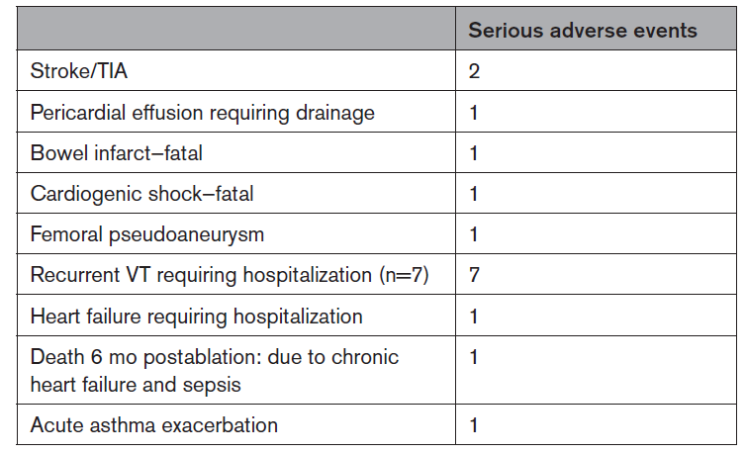
Needle RF Ablation: A First-in-Man Trial
Adverse Events With Needle Electrode Ablation
Packer DL, et al. Circ Arrhythm Electrophysiol. 2022.

Slide 20
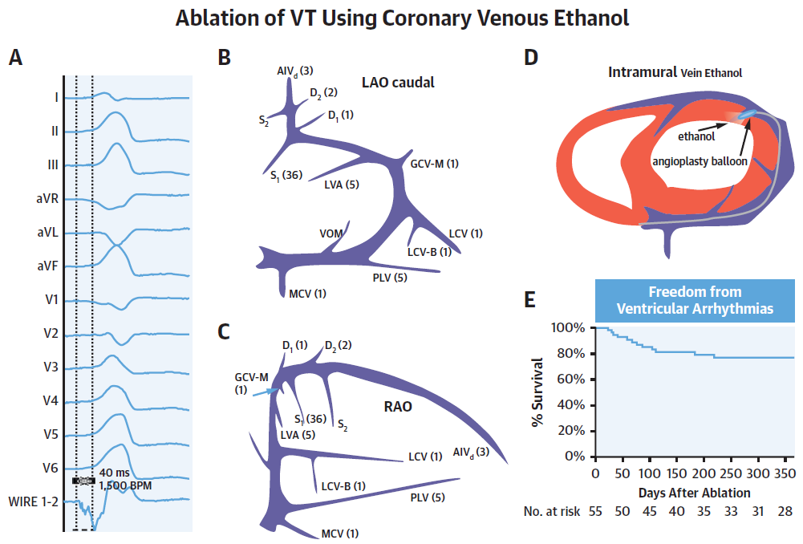
Intramural Venous Ethanol Infusion
Outcomes of a multicenter experience, n=63 (age 63±14 years; 60% men) with VAs (76% LVS origin)
Overall success in 55 of 56 (98%), 77% were free of recurrence at 1 year
Tavares L, et al. JACC Clin Electrophysiol. 2020.

Slide 21
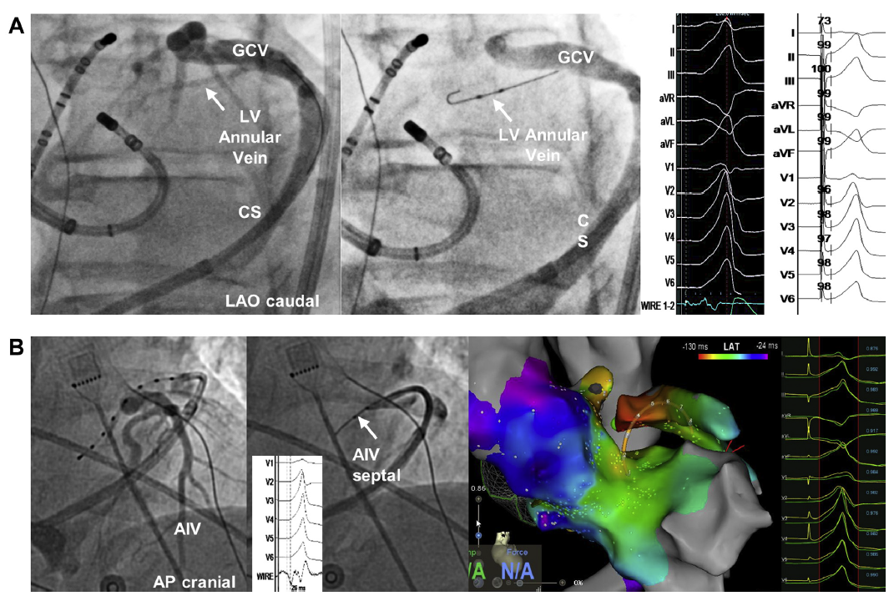
Intramural Venous Ethanol Infusion
LVS Ethanol Injection in Proximal LVS Veins
Tavares L, et al. JACC Clin Electrophysiol. 2020.

Slide 22
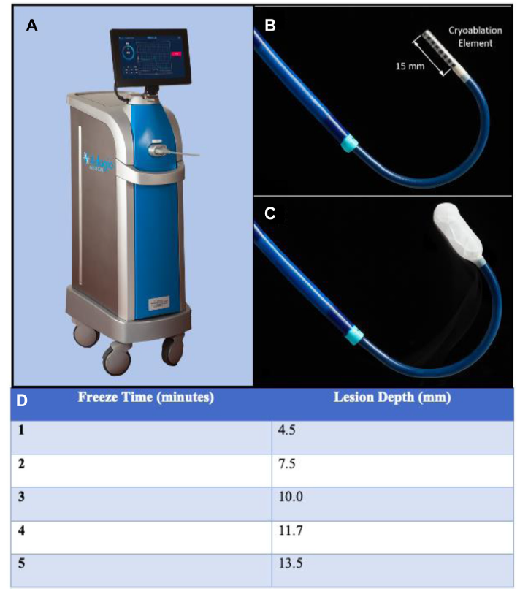
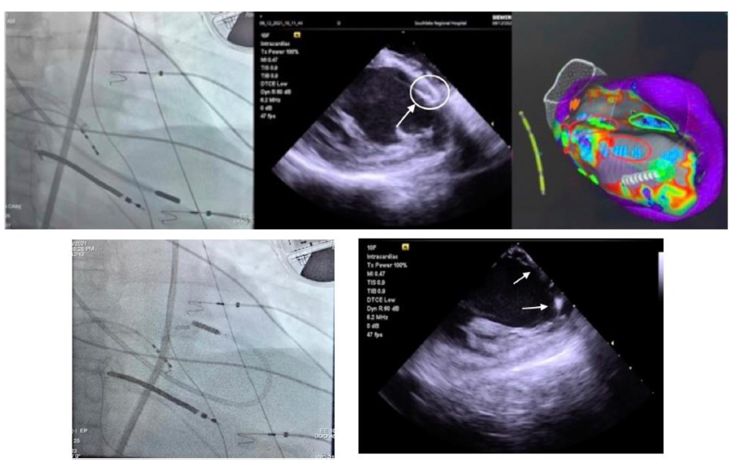
Ultra-low-temperature Cryoablation (ULTC)
Near-critical nitrogen has a much more favorable cryogenic properties and is able to generate temperatures as low as -196°C
Adagio Medical ULTC system
79-year-old man with ischemic VT
Sanchez-Somonte P, et al. HeartRhythm Case Rep. 2022 May 18;8(8):549-553.

Slide 23
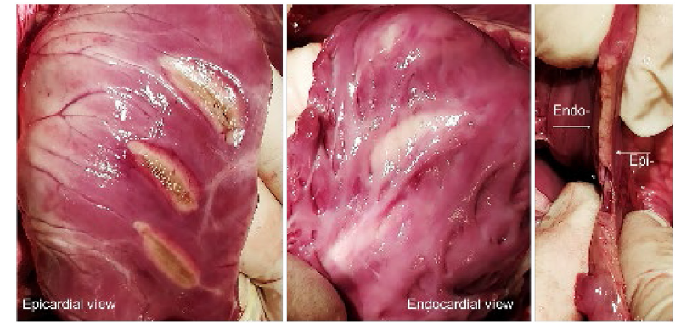
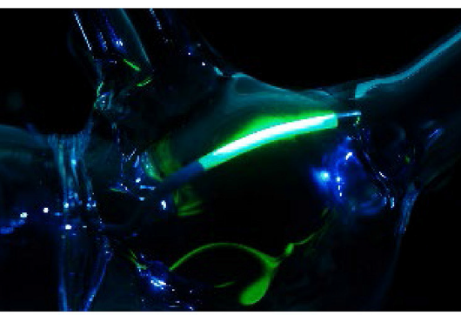
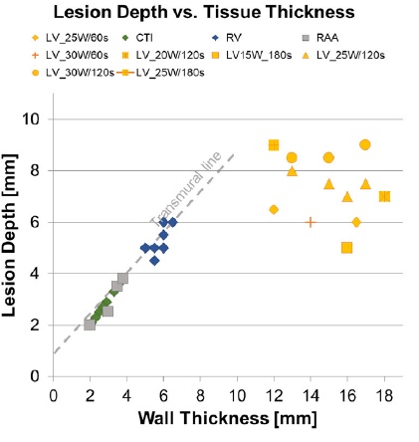
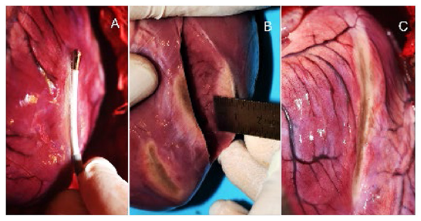
Laser Energy Ablation Catheter
The experimental 20mm linear laser catheter witha bidirectional steerable 8.2F shaft and saline irrigated tip
An in vivo proof-of-concept study in 6 swines
Epicardial ablation of the RV and LV
Laser ablation catheter
Krist D, et al. Front Med Technol. 2022.

Slide 24
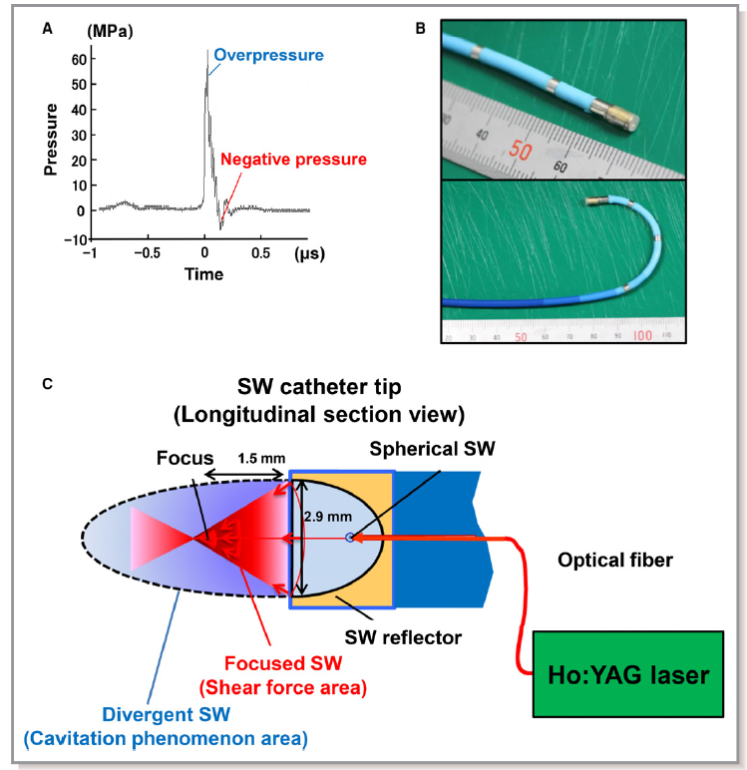
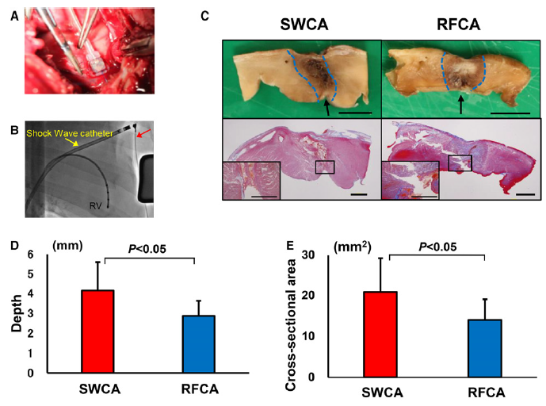
Shock-Wave Catheter Ablation System
Shock waves is an acoustic pressure wave consisting of a compressive phase (overpressure) followed by a tensile phase (negative pressure).
Shock waves can be applied to deep lesions without heat.
Characteristics of the SWCA system
Validation Study in Pigs In Vivo
Morosawa S, et al. J Am Heart Assoc. 2019.

Slide 25
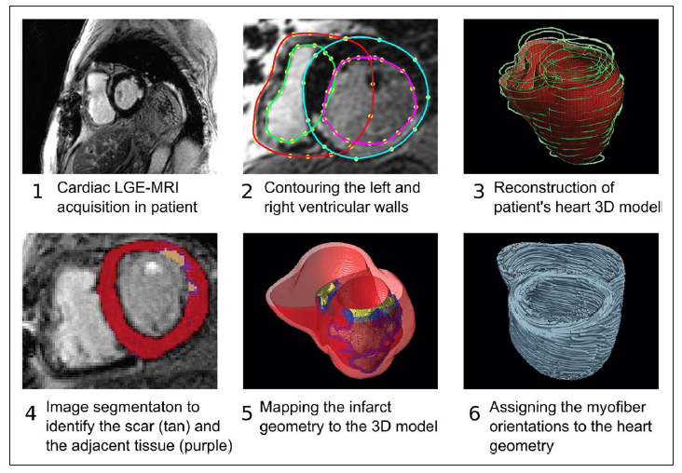
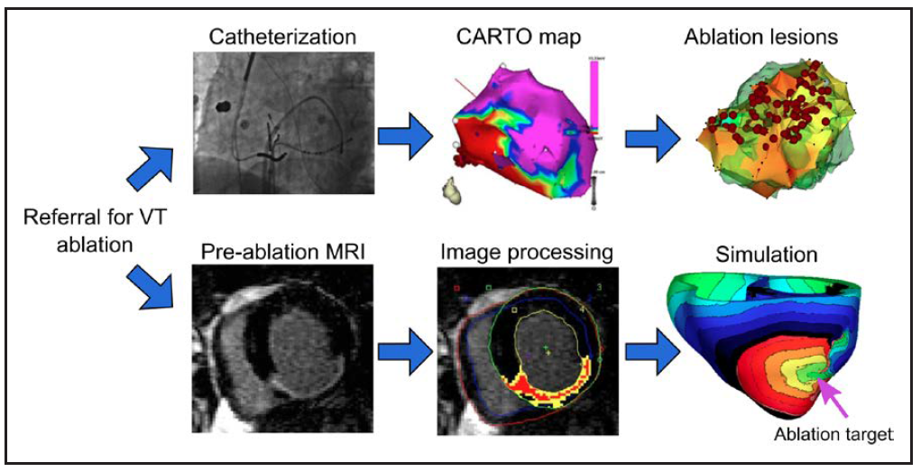
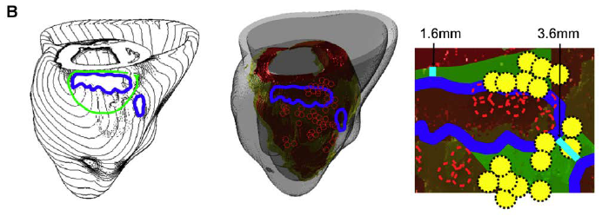
Image-Based Simulations for VT Ablation
Construction for heart model
VT ablation workflows
MRI–based simulation approach for VT ablation
Trayanova NA, et al. Circ Arrhythm Electrophysiol. 2017.

Slide 26
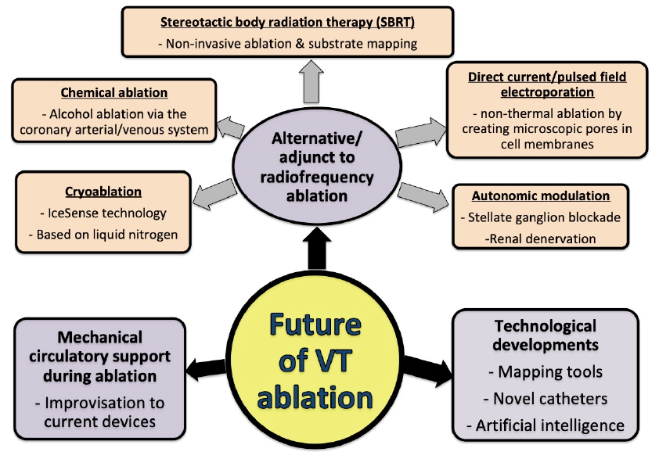
Future of VT Ablation
VG LIM. BCS Editorial 2020.

